Slide 1
WIS 2.0 MQTT Pub/Sub Mesh Demonstration
Https://github.com/MetPX/wmo_mesh
Briefing for WMO - ET-CTS Meeting – Buenos Aires
February 2019
Peter Silva

Slide 2
Why MQTT?
Decades old, originally for oil pipeline monitoring.
Efficient for embedded use. Wide adoption
Original design is for remote data collection.
Originally proprietary, now ISO/IEC 20922:2016
native/inherent pub/sub.
Good interoperability among implementations (mosquitto & EMQT for example.)
<number>

Slide 3
The Pub/Sub Mesh Algorithm
Web server with date-indexed tree.
local/national files uploaded to local server.
Local server: web server and message broker.
Message posted locally for each file.
Peers subscribed, see file, might download
If downloaded, post locally for their subscribers.
<number>

Slide 4
YYYYMMDDHH/CCCC/TT/
Web server with date-indexed tree.
local/national files uploaded to local server.
Local server is both web server and message broker.
Message posted locally for each file.
Peers subscribed, see file, might download
If downloaded, post locally for their peers.
What do the messages look like?
<number>

Slide 5
[ timestamp, baseurl, relpath, headers ]
JSON ( IETF RFC 7159 )
Restrict to UTF-8 encoding only (avoid BOM)
tuple for fixed fields, Array for variable ones.
Timestamp: "20190120045018.314854383"
Baseurl: "http://CCCC.tld/data"
Relpath: “2019012300/KWNB/SX/SXUS22_KWNB_230000_RRX_e12080ee6aaf254ab0cd97069be3812b.txt”
Headers: { “sum”: “99240486f422b0cb2dcead7819ba8100” }
<number>

Slide 6
Timestamp
"20190120045018.314854383"
exact moment when data was inserted into network.
Used to evaluate propagation delay (aka: lag)
YYYYMMDDHHMMSS.fff...
ISO8601 based.
Used for the base of file tree.
Unchanged when re-publishing.
<number>

Slide 7
Baseurl
Baseurl: "http://CCCC.tld/data"
Static root of retrieval URL
( https://url.spec.whatwg.org/ )
Allows variety of transports to be used...
Http, ftp, sftp, ... ipfs (future...)
Enables third party transfer
Load balancing
Publishing on behalf of other centres
Replaced when republishing.
<number>

Slide 8
Relative path
Relpath: “2019012300/KWNB/SX/SXUS22_KWNB_230000_RRX_e12080ee6aaf254ab0cd97069be3812b.txt”
Relative path (from the base)
Unchanged on re-publishing.
<number>

Slide 9
headers
Headers: { “sum”: “d,99240486f... d7819ba8100” }
JSON array ( name:value pairs )
One mandatory one: the checksum.
Additional keys may include arbitrary metadata:
“from_cluster”: <node> <--- where to return telemetry to.
“mtime”: <-- modification time of file at source.
“source”: <-- authority on data referenced.
Etc...
<number>

Slide 10
Sum validation
“sum”: “d,99240486f... d7819ba8100”
Validated during republishing:
inaccurate sums result in loops (BAD!)
First character selects algorithm.
selectable algorithms accommodate data types where equivalent items are not identical.
Algorithms must be agreed (validated by subscribers)
d - MD5 – IETF RFC 6151
s - SHA512 – NIST/FIPS/CSE -180
n – MD5 but only on the file name.
<number>

Slide 11
Topic Prefix (base of subscription tree)
xpublic/v03/post/ <relpath without filename>
Prefix: xpublic
public exchange convention from Sarracenia
Just need a convention.
V03 defines the version of the message format.
Post defines the message type
In Sarracenia, there are also:
pulse (a sort of keepalive)
report (for telemetry returned)
<number>

Slide 12
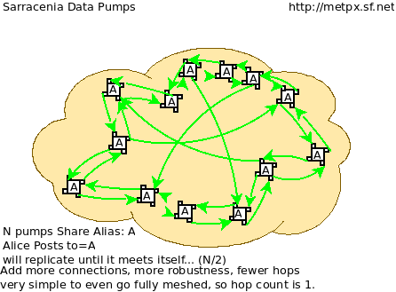
All nodes using Algorithm gives a mesh

Slide 13
mesh_peer.py Sample Output
topic: xpublic/v03/post/2019013003/AMMC/FT
payload: ['20190130033822.951880', 'http://blacklab:8000/data', '/2019013003/AMMC/FT/FTAU31_AMMC_292300_AAC_c267e44d8cfc52af0bbc425c46738ad7.txt', { 'sum': 'd,c267e44d8cfc52af0bbc425c46738ad7' }]
lag: 33.924 (mean lag of all messages: 43.8674 )
writing attempt 0: data/2019013003/AMMC/FT/FTAU31_AMMC_292300_AAC_c267e44d8cfc52af0bbc425c46738ad7.txt
calculating sum
published: t=xpublic/v03/post/2019013003/AMMC/FT, body=[ "20190130033822.951880", "http://cwnp:8000/data", "/2019013003/AMMC/FT/FTAU31_AMMC_292300_AAC_c267e44d8cfc52af0bbc425c46738ad7.txt", { "sum": "d,c267e44d8cfc52af0bbc425c46738ad7" }]
<number>

Slide 14
One Must Take Care of Lag
regardless of protocol (MQTT, AMQP, ...)
Subscribers must keep up with publishers
Otherwise queueing builds up.
Eventually messages are lost.
If a subscriber is too slow, one must either:
Subscribe to less (divide and conquer)
Get more workers. (AMQP consumers)
<number>

Slide 15
In MQTT by Tuning Topic Subscriptions.
Much easier in AMQP (using instances)
Multiple consumers for a single queue
--subtopic ‘+/+/IU/#’
+ wildcard for one topic
# wildcard for rest of topics
selecting BUFR from anywhere
--subtopic ‘+/KWBC/#’
Select all products from KWBC
Instead of one process running the connection,
multiple processes with partial subscriptions.
<number>

Slide 16
Every Node: Subscribe >=2 Others
if each node subscribes to two others, they are resistant to the failure of any other single node.
Those subscriptions do not need to be complete, could ask for different subsets of data from different nodes.
The additional subscriptions do not add to volume of data transferred (since all data downloaded only once)
But doubles message traffic (messages would be better off small.)
More connections reduce lag.
<number>

Slide 17
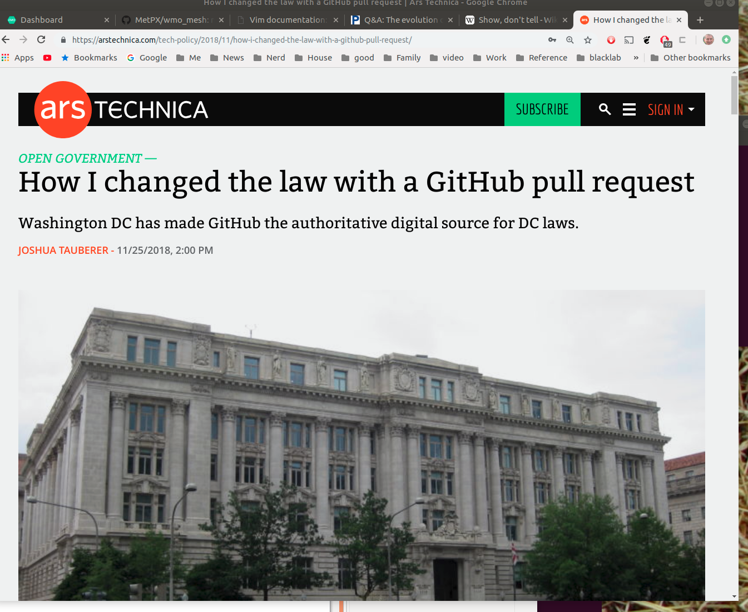
Evolve/Track Progress (1)
<number>

Slide 18
Evolve/Track Progress (2)
Show Don’t Tell:
git clone https://github.com/MetPX/wmo_mesh
Illustrate change with branch
When agreed, we accept a pull request.
With a reference implementation, members free to re-implement in their preferred stack.
easy interop tests.
Word documents are awful (binary, viruses, size, etc.)
Could add the draft document as well. See README.rst in repo (just UTF-8 raw text.)
<number>

Slide 19
Thanks!
The End
http://github.com/MetPX/wmo_mesh
<number>

