Slide 1
Pub/Sub File Trees for WIS 2.0
Briefing for WMO - ET-CTS Meeting – Buenos Aires
February 2019
Peter Silva
Notes:
Sorry for WMO people… other reviewers don’t know the lingo…
WMO – World Meteorological Organization
ET – expert team
CTS – computing and telecommunications systems.
ET-CTS used to be a technical sub-committtee of the Committee for Basic Systems of the WMO.
It might still be, there are reorganizations in the works of which I am only dimly aware.

Slide 2
WIS 2 Should Move More, Larger Data Types
important data sets are much larger.
Earth Observation Satellite
Meteorological Radar
Meteorological/Environmental Observations (many types)
Aviation Forecasts (ASCII & XML)
NWP Model products (.grib, .hdf, NetCDF, etc… )
CAP Warnings can embed media (complex type, large.)
Non GTS exchanges dwarf GTS
No longer only small text files
Formats vary over time (relatively quickly)
1
Notes:
WIS – WMO Information Service intended to replace:
GTS – Global Telecommunications System (the way members of the WMO exchange *essential* weather data in real-time) it’s really old, and about the only thing left in service is the naming of products, by using Abbreviated Header Lines (AHL’s)
ASCII – American Standard Code for Information Interchange basis for all common character sets used to send alphanumeric data. These days it has been replaced by UTF-8 a Unicode character encoding. Older data formats are sometimes informally referred to as ASCII or Traditional Alphanumeric Code (TAC.)
XML Extensible Markup Language, Very popular last decade, more structured format than TAC. Voluble.

Slide 3
With good security,
Minimize amount of server code to review
Use common, widely available services.
Already audited by others.
Preferably no write access others´ servers.
Each member writes to own server only.
Connect to remote server as read-only guest
1

Slide 4
Transparency, and Manageability Also!
well-known APIs: browsers, CLI clients, libraries.
Use available open source solutions.
File transport is solved problem: http, sftp…
But could evolve.
Ease of inspection
Simple tools to browse members´ servers.
1
Notes:
API – Application Programmer Interface methods to enable programmatic access to services. API’s are typically programming language specific, and require implementations for each language used. There is currently an infatuation with creation of web api’s which needs to be tempered with an understanding of programming eco-systems and standardization.
CLI – Command Line Interface, an API which also works well with script programmings languages, and is directly usable by a large subset of specialist humans.

Slide 5
large scale means as simple as possible
B2B, high volume, real-time
visual appeal not a concern
Wholesale vs. retail data transfer
Least complex technology to solve the problem
minimize compute/io/network bandwidth
Flexible: if new data types added, add folders.
browse without downloading.
Sovereign domestic service
1
Notes:
B2B – Business to Business transfers. As opposed to dealing with individuals, these exchanges of data occur on an organizational scale.

Slide 6
One transport option: (S)FTP(s)
Strengths:
open source servers available.
folders are simplest API.
Well-known, very easily scaled for retrieval.
Weaknesses
large/deep trees too expensive (not used.)
Authentication complicates interactions.
ls/fetch cycle limited performance.
1
Notes:
FTP – File Transfer Protocol (obsolete)
SFTP – SSH File Transfer Protocol (good!)
FTPS – FTP over SSL (bad replacement for FTP)
Details:
https://github.com/MetPX/sarracenia/blob/master/doc/sftps.rst

Slide 7
Another transport Option: HTTP(s)
Strengths:
Many open source web servers available.
Web accessible folders simplest API.
Very easily scaled for retrieval.
Works well with anonymous access
Weaknesses
large/deep trees expensive to walk
Hard to know what is new without walking
Hard to know what is old without walking.
1
Notes:
HTTP – Hyper-Text Transfer Protocol. The originally normal protocol of the web. Adding an S (for secure) means enveloping HTTP in a standard encryption layer known originally as Secure Sockets Layer (SSL), but now officially called Transport Level Security (TLS) older versions are all considered insecure at this point, so version numbers are important.
So, HTTPS is HTTP over TLS ( >= 1.2)

Slide 8
Efficient Large Trees Need Time & Pub/Sub
Motivated by Operational Met Service Production and Dissemination
Organize tree by time for efficiency of all:
Current users look in current data.
Cleanup processes examine smaller tree.
Retention policy obvious from root of tree.
Notification Layer
Client subscribe to interesting parts of the tree.
Do not need to walk it.
1

Slide 9
Avoid walking trees by using Pub/Sub.
Notification topic hierarchy reflects file one.
Subscribe to parts of trees.
Server-side filtering limits notice volume.
Very low latency notice forwarding.
Notification Layer
Client subscribe to interesting parts of the tree.
Do not need to walk it.
1

Slide 10
How to Pub/Sub: Choices
Many technologies exist.
RSS/Atom, Web sockets, XMPP/Jabber,
MQTT promising now!
STOMP, AMQP 1.0 (socket protocols)
Many others (RTMP, DDS, PubNub, SSE...)
AMQP ( 0.8 and/or 0.9.1 ) best in 2008!
Looked for option with least server-side code required (most built-in support.)
1
Notes:
Google will define most of these. They are mentioned merely as examples among dozens of others available.
AMQP – Advanced Message Queuing Protocol – a messaging protocol that arose out of the financial industry in the early 2000’s. http://www.amqp.org
MQTT – used to be Message Queue Telemetry Transport, but now is officially just the name of the protocol and does not stand for anything. http://www.mqtt.org, started in the late ‘90’s to transmit oil pipeline monitoring data via satellite, was proprietary through the 2000’s, has recently (2016) become a ISO standard.

Slide 11
AMQP <= 0.9.1* (RabbitMQ, Qpid, others)
Messaging Swiss Army Knife
Supports many communication patterns
Wide adoption by many different industries.
Very robust in practice.
Deployment simplifications for this use.
only topic-based exchanges
zero (0) server-side code. Unmodified broker is the server.
1

Slide 12
AMQP <= 0.9.1 Concepts
Brokers: AMQP server (user permissions, CRUD of Exchanges, Queues, and Bindings.)
Publishers send messages to Exchanges
Consumers get messages from Queues.
Bindings select a subset of messages on an exchange to be placed in a queue .
Exchanges and Queues can be used by multiple producers and consumers.
1

Slide 13
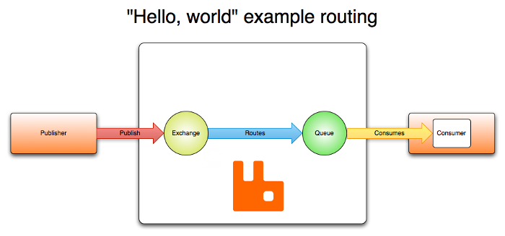
AMQP Concepts
Notes:
Diagram courtesy of rabbitmq.com.

Slide 14
AMQP (<1.0) Exchange Types
fanout (1:N), Direct (1:1) Topic (pub/sub)

Slide 15
The pub/sub Mesh Algorithm
Web server with date-indexed tree.
local/national files uploaded to local server.
Local server is both web server and message broker.
Message posted locally for each file.
Peers subscribed, see file, might download
If downloaded, post locally for their peers.
If everyone does it, we end up with a shared tree.
1

Slide 16
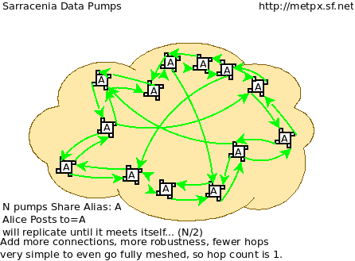
Result of Composition is a mesh

Slide 17
Slightly Lower Bandwidth Costs?
GTS is implemented over RMDCN
Logically point to point, physically star.
Links are symmetric (upload/download speeds)
RTH’s need more bandwidth to feed their clients
Mesh distributes uplinks among peers
uplink of most peers is less used (but costs!)
Peers uplink more, RTH less.
May reduce cost of network, on the whole.
At least will distribute more fairly.
1
Notes:
GTS – Global Telecommunications Service (of the WMO) current obsolete standards for international exchange of data between WMO members.
RMDCN – Regional Main Data Communications Network. An MPLS (Multi-Protocol Lan Service) procured by ECMWF originally for region VI (Europe.) Being adopted world-wide as defacto physical connection to support GTS.
RTH – in the GTS, a Regional Telecommunications Hub, where countries on the same continent receive their data using a point-to-point link from their local RTH. The point-to-point leased line connections have largely been de-commissioned in favour of higher bandwidth RMDCN connections.

Slide 18
Status of Sarracenia (pub/sub on AMQP)
deployed on about 100 servers (but not in a mesh)
Apache/httpd,
OpenSSH &
RabbitMQ.
Deployed on Linux, many other uses cases
Ubuntu 12.04 → 18.04
Python 3.2 → 3.7
A little more work for: redhat/centos/suse
1

Slide 19
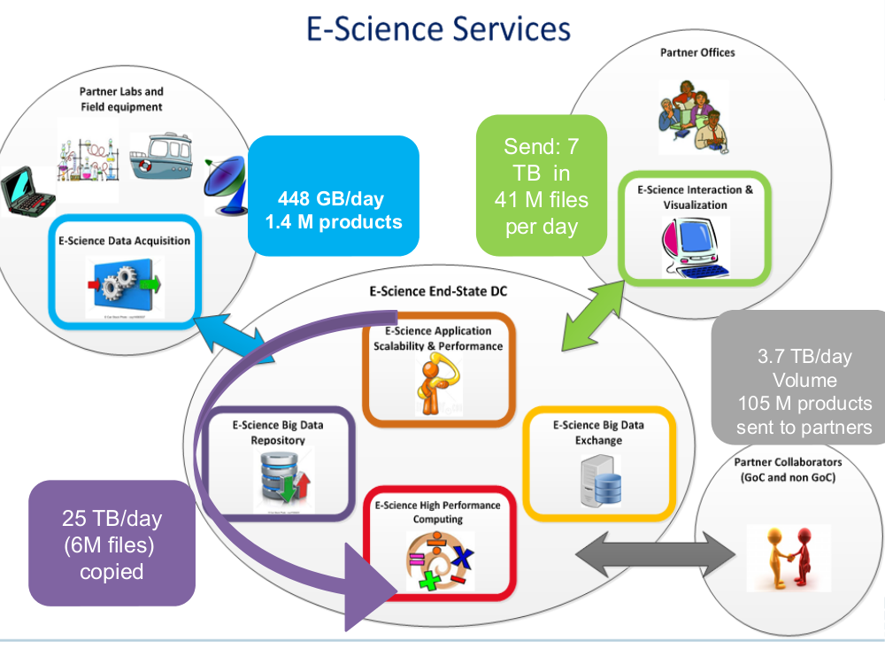
Daily AMQP Pub/Sub at CMC, Early 2018

Slide 20
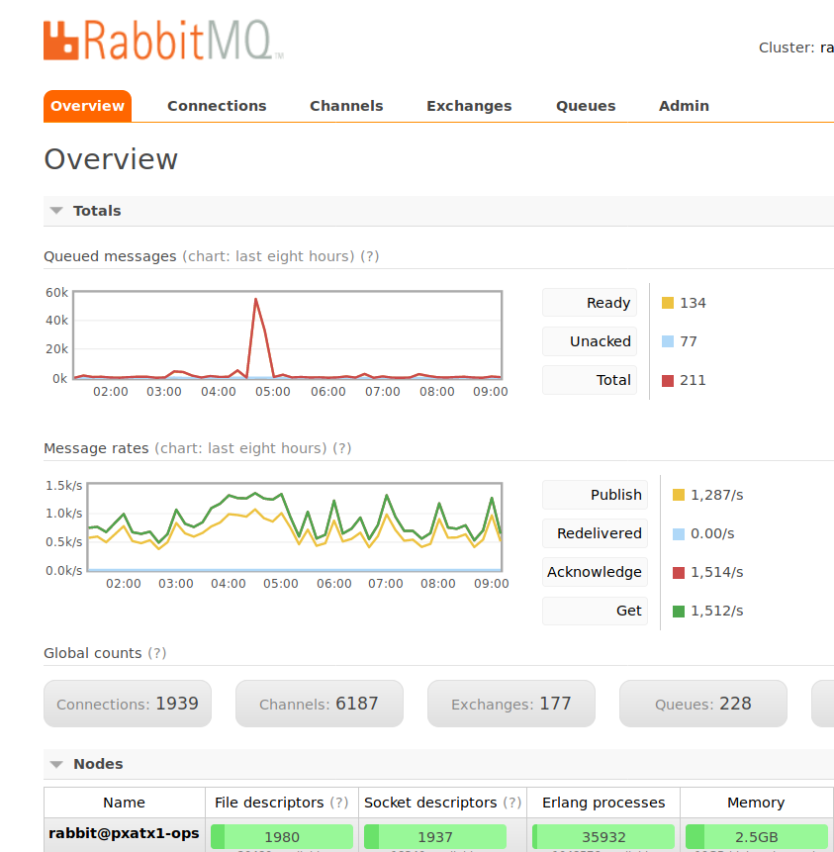
Snapshot of Main Internal Broker

Slide 21
Next Steps for Canadian Stack (Sarracenia)
AMQP 0.9 works well without server-side code.
Continue decommissioning old services
HPC Mirroring v2
V03 (pure JSON) data format:
Fixes 255 character limit AMQP headers
Compatible with MQTTv3X
Prototype in Sarracenia v2.19.01b1
MQTT? ( https://github.com/MetPX/wmo_mesh )
1

Slide 22
Questions
Agree on approach?:
distribute a common tree with pub/sub.
Begin work to settle on a common tree
Starting point:
YYYYMMDDHH/CCCC/TT/<normal file_name>
TT could gradually expand to things like satellite/, radar/, global_ensemble/ (not that such data would circulate there, but common mechanism helps.)
1

Slide 23
Thanks!
The End
Sample:
http://hpfx.collab.science.gc.ca/~pas037/WMO_Sketch/
1

Slide 24
Mapping AMQP to MQTT
AMQP Term | MQTT Term | Description
Exchange | Root of topic hierarchy | Defining a name space for messages.
Queue | Client-Id | Stores connection state.
Bind | Subscribe | Define topics of interest to a subscriber.
Sarracenia use of AMQP for pub/sub maps easily to MQTT
Messages, topics, subscribers, publishers terminology the same.

Slide 25
Sample v03.post Notice
20190115224253.926 http://dd5.weather.gc.ca /hydrometric/csv/AB/hourly/AB_05AH025_hourly_hydrometric.csv headers={ 'to_clusters': 'DDSR.CMC,DDI.CMC,CMC,SCIENCE,EDM', 'atime': '20190115224253.926', 'from_cluster': 'DDSR.CMC', 'mtime': '20190115224253.926', 'sum': 'd,d48d9f2ece1658b09002d503620ae378', 'source': 'WXO-DD', 'parts': '1,38919,1,0,0'}
1

Slide 26
Bio.
In charge of CWAO WMO switch since 2001
In 2004 started replacing WMO switch software:
450 kloc Tandem app for WMO message switching
50 kloc UNIX app in C for file switching.
Replacement (2007): MetPX Sundew
Built-inhouse by careful study of WMO-386
Blackbox reverse engineering.
Gen 1 WMO switch & file switch (& AFTN)
25 kloc python script on Linux (98% less code)
1
Notes:
CWAO – is the origin code (CCCC) for Canada’s GTS node.
AFTN – Aviation Fixed Telecommunications’ Network. A ground-based network interconnecting airports around the world to support aviation. AFTN itself is obsolete, and being replaced by Aviation Message Handling System (AMHS.) Unfortunately, AMHS itself is largely obsolete and would is need of update or replacement.
( https://www.icao.int/safety/acp/Pages/AMHS.aspx )
Kloc – Kilo-Lines of Code (thousands of lines of code) and indicator of the size of source code of an application. (see: Mythical Man Month - Brooks, F.)

Slide 27
Bio (2)
Sundew replaced X.25 WMO link with a TCP/IP one.
2008, looking at pub/sub.
Settled on AMQP as an experiment.
Rolled out to public datamart as experimental service
2010, initial mesh for redundant RADAR production.
2013 Sarracenia: pub/sub with AMQP.
ground-up re-write. 16Kloc (30% code reduction)
Incremental DevOps deployments.
2018 initial feature complete version.
1

Slide 28
Traditional GTS (WIS 2 seeks to replace)
Nodes: NC/RSMC/RTH
National Centres, Regional Specialized Meteorological Centre, Regional Telecommunications hub.
NC->RTH->RTH->NC (communications required to add data between two countries in different regions.)
No official distribution outside WMO members.
Data types defined (restricted?) by WMO-306
Communications standards by WMO-386 (renamed?)
Very obsolete, mostly unneeded.
1

Slide 29
GTS at CWAO evolution over past 20 years
2006 GTS sockets X.25 -> TCP/IP
2008
Eliminated segmentation (still not done.)
Maximum size 14,000 --> 500,000 bytes (still in progress)
Convention for bucketing (grouping files.)
UKMET exchange uses buckets
2010 naming conventions for FTP exchanges.
2015 migration to SFTP over Internet for NWS.
non-standard file names, shallow tree with delete.
1

Slide 30
CWAO Important File Exchanges (non GTS)
Almost always one-off bilateral arrangements.
Participation in TIGGE & NAEFS
Subscription to US PDA (deep file tree, hard to do efficiently, no delete.)
Almost all internal data distribution (use Sarracenia)
GOES, HRPT, raw and processed
RADAR volume scans and products
Model outputs in GRIB and FST.
Public data mart ( dd.weather.gc.ca )
Volume completely dwarfs GTS.
1

Slide 31
Aspirations: GTS should not be “Special”
File exchange is more important than GTS today.
Most organizations do not support pub/sub.
File exchanges require inefficient polling.
Many odd things done to get around that.
Many bilateral arrangements different for no reason.
Most do not understand anything better is possible.
Evolution in Aviation Telecom:
CWAO still has an AFTN (over TCP/IP)
Being asked to look at AMHS (OSI, yuck!)
AMQP 1.0 (yuck!)... simpler pub/sub better!
1

Slide 32
Aspirations 2: Pub/Sub broader than GTS
Identical methods can be used to disseminate a wide variety of scientific data, to a much wider audience.
My mandate includes: Astronomy, Genetic, and other data sets. Hope to use same stack.
Directory tree convention is specific to GTS.
GTS used to be inadequate, with working standard
Could approach others to have file exchanges use it.
For MQTT in particular, data acquisition is now called IOT. Acquisition and exchange could have common basis.
1

