Slide 1

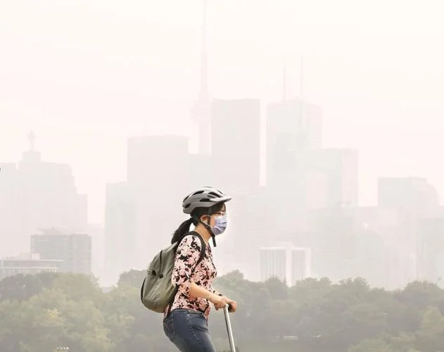
A Taste of Air Quality Research and Applications
Provide a small taste of ambient (outside) air quality research and applications from a more national perspective.
Mark Shephard + contributions from other ECCC Scientists
Air Quality Research Division (AQRD)
Environment and Climate Change Canada (ECCC)
Pedestrians are seen making their way beside Riverdale Park east on Broadview north of Gerrard as the skyline is obfuscated by the smoke in the distance. Toronto had the world’s worst air quality on Wednesday, according to global air quality tracker IQAir, as smoke from forest fires over northeastern Ontario and Quebec June 28 2023.
Richard Lautens / Toronto Star
Wearable technology, developed with funding
from the NSERC Discovery Grants program
Source: Western University
Guest Lecture at Fleming College, School of Environmental & Natural Resources
Lindsay, Ontario, Canada, March 22, 2024
.

Slide 2
Outline
Motivation to study ambient air quality
Air pollution background
Air quality and health applications
  Air Quality Health Index: acute (short-term) exposure to pollutants
  New multi-pollutant index for chronic (long-term) exposure of a mixture of pollutants
  UV index (Stratospheric Ozone)
  New dataset integrating air quality, health, and social-economic data
ECCC air quality research and applications examples:
  Emissions inventories and air quality modelling
  Satellite remote sensing of air pollution
    Using satellites to detect trends
    Research and application example using ECCC produced satellite ammonia observations

Slide 3
Motivation to Study Air Pollution
Poor air quality is major environmental risk factor for premature death globally
  World Health Organization estimates ~7 million premature death per year
    Ambient (outdoor) air 4.2 million per year in 2019
    Greatest burden in China and India
Air pollution can have negative economic impacts
  Most cost damages are due to human health impacts:
    Example: Air pollution cost the US an estimated ~100 billion in annual damages in 2002 (mainly illness) (Muller and Mendelsohn 2007)
  Others costs like reduced agriculture yields
Most outdoor air pollution sources are well beyond the control of individuals, thus requires action by local, regional and national level policy makers
Air Pollution silent killer (who.int)
Air pollution has adverse health, environment, and economic impacts globally
Sources: https://www.who.int/multi-media/details/air-pollution-silent-killer; https://www.who.int/news-room/fact-sheets/detail/ambient-(outdoor)-air-quality-and-health; https://www.sciencedirect.com/science/article/abs/pii/S0095069607000095; https://www.nature.com/articles/s41467-018-06885-9

Slide 4
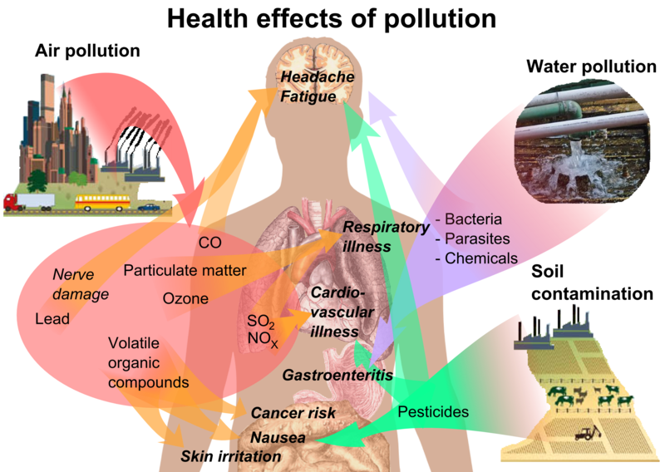
Motivation to Study Air Pollution
Why do we care about air pollution in Canada…is it really that bad?
  Compared with some other polluted regions of the world Canada overall has relatively lower levels of air pollutants, but it still impacts population health (especially at local scales).
    Health Canada estimates ~15,000 (42 per 100,000) premature deaths per year in Canada (2019) attributed to ambient air pollution
Air pollution has a significant impact on the health of Canadians
File:Health effects of pollution.png - Wikipedia
Sources: Health Impacts of Air Pollution in Canada 2021 Report: https://www.canada.ca/en/health-canada/services/publications/healthy-living/health-impacts-air-pollution-2021.html

Slide 5
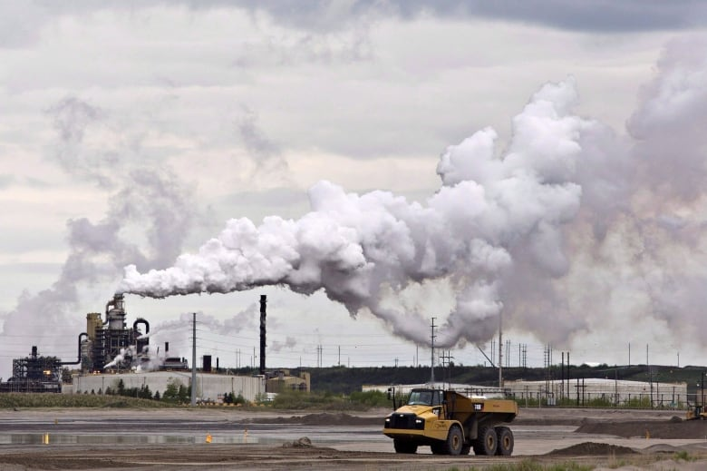
Ambient Air Pollution: Background
Mixture of substances in the air that have adverse impacts on human health and the environment
Vary in emission sources, chemical composition, how long they last in the atmosphere (lifetime)
Can be loosely be grouped into 4 categories sharing similar characteristics:
  Toxics (e.g. benzene)
    Pollutants that are poisonous or toxic to human health and the environment
  Heavy Metals (e.g. mercury and lead)
    Metal elements transported by the air and enter our water and food supply
      e.g. mercury levels in when eating fish is a concern during pregnancy
  Persistent Organic Pollutants (POPs) (e.g. pesticides)
    Last in the environment for a long period of time often travelling long distances
    Main concern is also entering the food supply, accumulate in body tissue
  Criteria Air Contaminants (CACs) and related pollutants
    A lot of different emission sources (e.g. fossil fuel combustion) causing ambient air quality issues
      Such as smog and acid rain
Northern Alberta Oilsands (Jason Franson/The Canadian Press)
Source: https://www.canada.ca/en/environment-climate-change/services/air-pollution/pollutants/overview.html

Slide 6
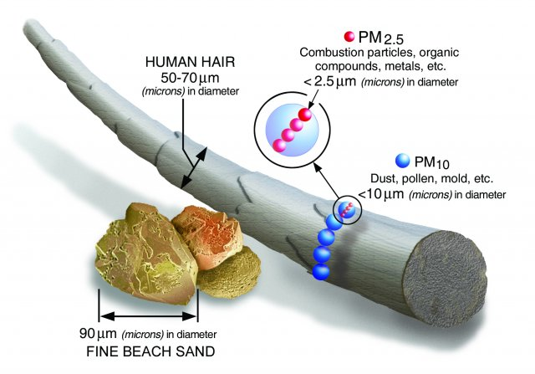
Air Pollution Background: Criteria Air Contaminants (CACs)
Sulphur oxides (SOx) (e.g. coal burning power facilities, smelters)
Nitrogen oxides (NOx) (e.g. combustion from gasoline vehicles, industry, power plants)
Ammonia (NH₃) (e.g. gas emitted mainly from agriculture (manure, fertilizer, livestock)
  Combines with other molecules in the atmosphere (sulphates and nitrates) to form secondary PM_{2.5}
Particulate matter/aerosols (PM) (e.g. dust, chemical reactions)
  Directly emitted (smokestack, dust) or secondary production in the air from chemical reactions of precursors (NOx & S0x with NH₃)
    PM_{2.5} poses the greatest health risk (cardiac and respiratory diseases (i.e. asthma, bronchitis)
Particulate Matter (PM) Basics | US EPA
PM_{2.5} is 30x smaller than hair
Volatile organic compounds (VOCs) (e.g. gasoline fumes & solvents, formaldehyde)
  Upstream oil and gas production, residential wood, evaporation of fuels & solvents
Carbon Monoxide (CO) (e.g. incomplete combustion of fuels)
  Vehicles, fires
Ground-level Ozone (O₃) (e.g. NOx + VOC + sunlight)
  One of the major constituents of photochemical smog
CACs & Health
Source: https://www.canada.ca/en/environment-climate-change/services/air-pollution/pollutants/common-contaminants.html
File:Health effects of pollution.png - Wikipedia

Slide 7
Air Quality and Health Applications
  “short-term exposure is related to effects that occur a few days after an elevation in ambient air pollution (i.e. acute health effects)”
  “long-term exposure refers to exposures averaged over the years preceding the development of disease or death (i.e. chronic health effects).”, Health Canada

Slide 8
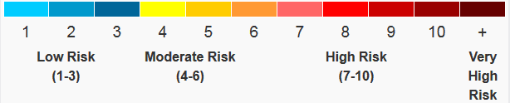

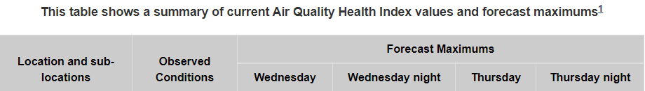
Air Quality and Health: Air Quality Health Index (AQHI)
Health index for acute exposures to outdoor air pollution
  Federal program by Health Canada and Environment and Climate Change Canada
  AQHI provides information on health risks of short-term exposure to air pollution to the public
    Combined observed relationships between NO₂, ground-level ozone, and PM_{2.5} with mortality
      Computed from hourly observations (or model forecast)
    Last summer across most of Canada we saw very high AQHI values associated with large forest fires smoke events
Health Risk | AQHI | Health Messages
 |  | At Risk Population* | General Population
Low | 1 - 3 | Enjoy your usual outdoor activities. | Ideal air quality for outdoor activities.
Moderate | 4 - 6 | Consider reducing or rescheduling strenuous activities outdoors if you are experiencing symptoms. | No need to modify your usual outdoor activities unless you experience symptoms such as coughing and throat irritation.
High | 7 - 10 | Reduce or reschedule strenuous activities outdoors. Children and the elderly should also take it easy. | Consider reducing or rescheduling strenuous activities outdoors if you experience symptoms such as coughing and throat irritation.
Very High | Above 10 | Avoid strenuous activities outdoors. Children and the elderly should also avoid outdoor physical exertion. | Reduce or reschedule strenuous activities outdoors, especially if you experience symptoms such as coughing and throat irritation.
AQHI is used to help reduce a person’s short-term exposure to outdoor pollution
Sources: https://weather.gc.ca/airquality/pages/index_e.html
https://www.canada.ca/en/environment-climate-change/services/air-quality-health-index/understanding-messages.html
Stieb, David, et al., "A New Multipollutant, No-Threshold Air Quality Health Index Based on Short-Term Associations Observed in Daily Time-Series Analyses". Journal of the Air & Waste Management Association. 58 (3): 435–450. doi:10.3155/1047-3289.58.3.435, 2012

Slide 9
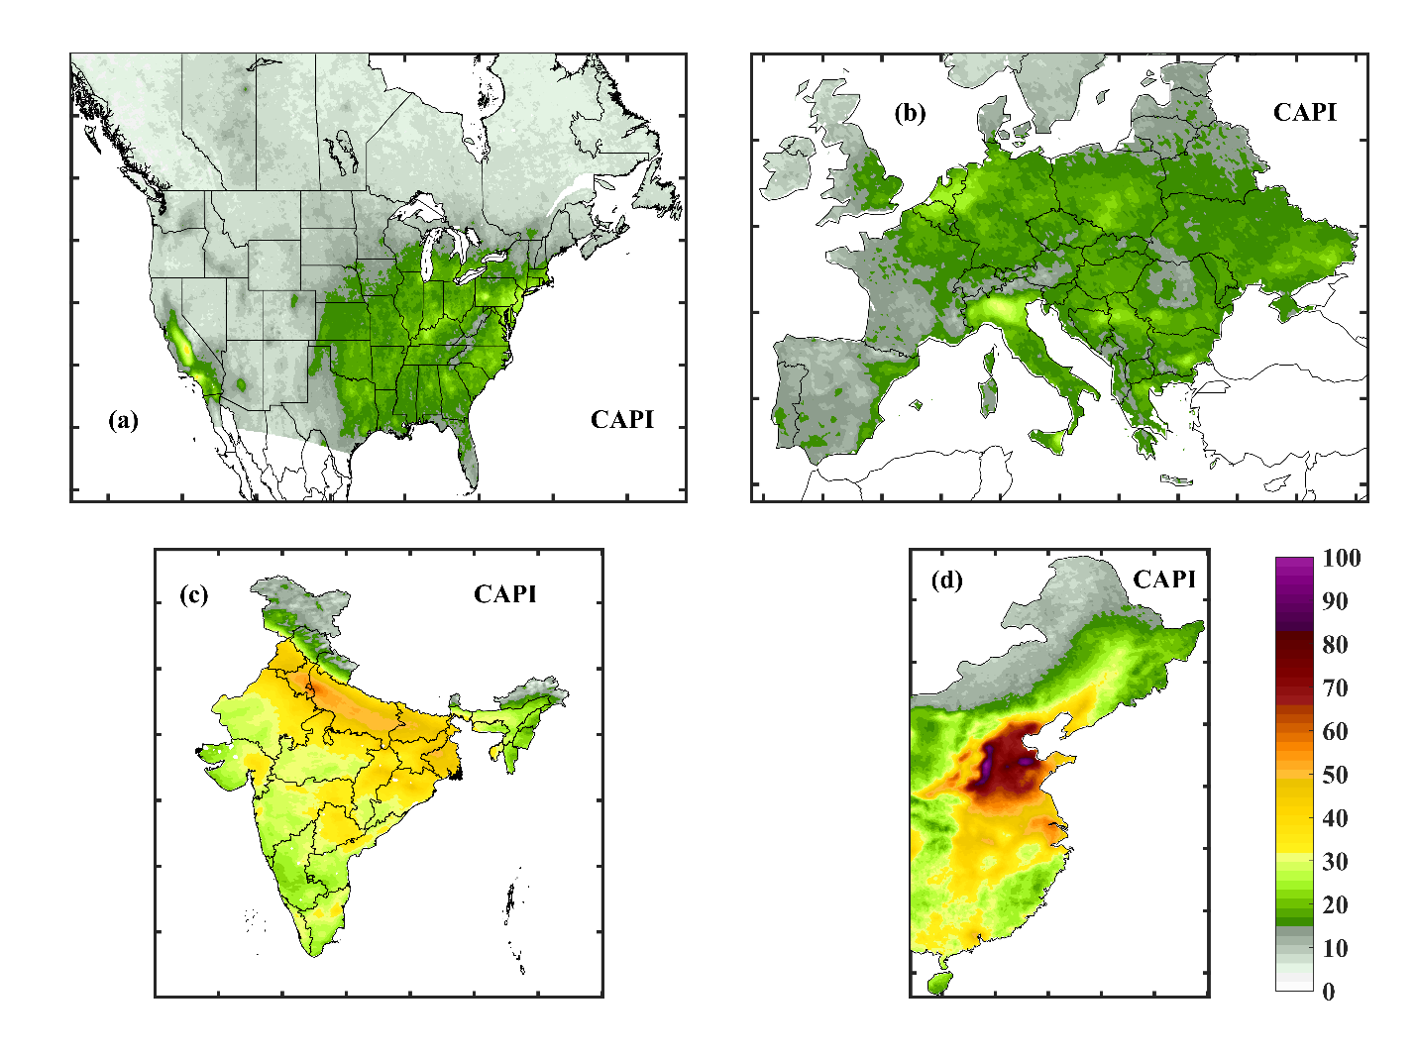


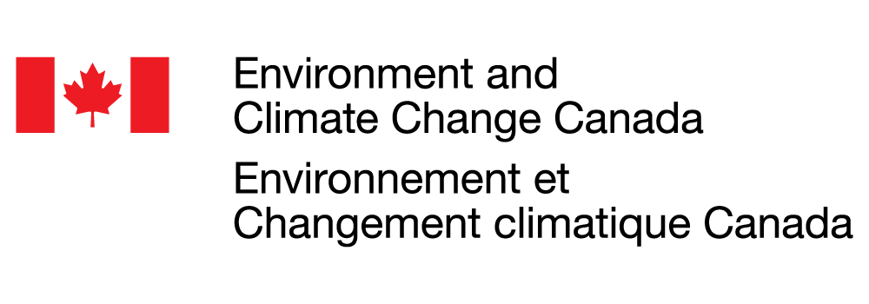
Air Quality and Health: CAPI Index
New R&D
Traditionally only fine particulate matter PM_{2.5} is used as a health indicator for chronic exposure
New multi-pollutant index of long-term air quality to be used for chronic exposure health impacts
  Chronic Air Pollution Index (CAPI) reflecting real-world mixture of air pollutions we breathe in
    Using satellite observations for pollutant mixtures (PM_{2.5}, NO₂, O₃, SO₂, CO, NH₃, formaldehyde)
      Provides complete spatial coverage
Geographical patterns of CAPI (2012-2014)
Europe
Ranking of 60 major cities across the Northern Hemisphere using Traditional PM_{2.5} & New CAPI
Large movement up in city ranking:
    New York: from 56th (PM2.5) to 25th (CAPI)
    Large movement down in city ranking:
    Sofia, Bulgaria: from 31st (PM2.5) to 55th (CAPI)
    Toronto, Montreal, and Calgary show small changes in ranking going from the single to multi-pollutant index.
North America
Traditional PM2.5 Ranking
New CAPI Ranking
Lower CAPI
India
China
Higher CAPI
We are developing a new index that incorporates real-world mixtures of air pollutants to help with chronic exposure to outdoor pollution
Reference: Brook, J .R., S.K. Kharol, M.W. Shephard, C. E. Sioris, C. A. McLinden, Characterization of Air Pollution Mixtures across the Northern Hemisphere to inform a Multi-Pollutant Index, submitted to the Lancet Planetary Health Journal, 2024.
Notes:
Much epidemiological evidence indicates that chronic exposure to air pollutants can have a greater adverse impact on health than acute exposures
Sensitivity analyses and geographic comparisons revealed a common thread in air pollutant mixtures across the
northern hemisphere related to combustion emissions.
NH3: Ammonia
HCHO: formaldehyde

Slide 10
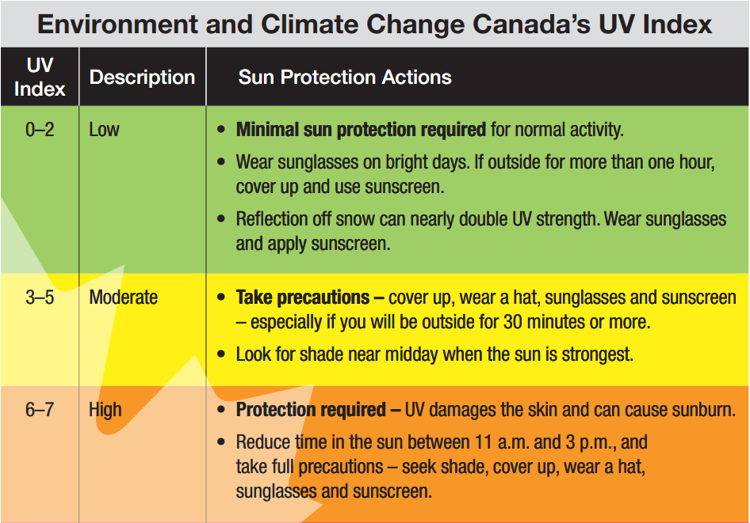
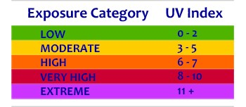
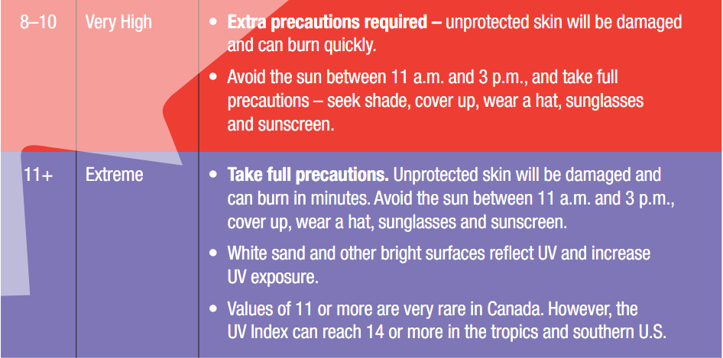
Air Quality and Health: UV Index
Canadian Success Story
Index created at ECCC in 1992 to protect Canadians from overexposure to the sun.
  World Health Organization (WHO) adopted it internationally in 1994, became a global standard in 2002.
  Protects us from exposure to UV rays that can cause skin cancer, sunburns, eye cataracts, skin aging
Index is a measure of the strength of the sun’s UV rays
  Based on ozone layer thickness, angle of the sun above the horizon, amount of cloud cover
    Stronger as you go south and around noon: expect the highest Canadian values in Southern Ontario around noon
UV index forecast (combining ECCC models with sun angle):
  Canadian Daily UV Index Forecast Bulletin
Canadian innovation to help reduce a person’s exposure to the sun’s rays
Sources: https://www.canada.ca/en/environment-climate-change/services/weather-health/uv-index-sun-safety/about.html; https://weather.gc.ca/airquality/pages/index_e.html

Slide 11
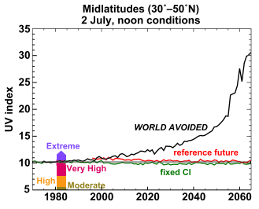
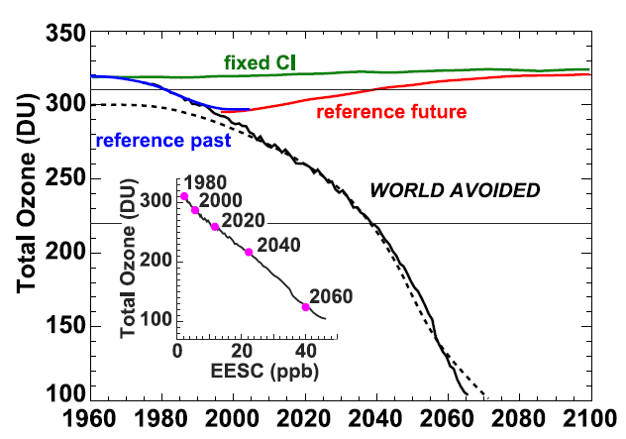
Air Quality and Health: UV Index : “World Avoided”
World Success Story
What would have happened to the ozone layer without the Montreal Protocol (1987)?
  Put into place control measures on ozone depleting chlorofluorocarbons (CFCs)
Model Simulations:
Global Annual Average Ozone
Working together the world reduced ozone depleting substances (i.e. CFCs) and avoided rapid depletion of the ozone layer and extreme UV exposure.
Ozone layer is showing signs of recovery
No longer thinning in most regions
Average UV across Canada remains a few % higher than they were before 1980.
Complete recovery not expected for decades
Still need to remain vigilant in monitoring and mitigation
  Old chemicals not completely phased out
  New chemicals to review
  Determine any impacts of climate change
Montreal Protocol
Reference past: model simulation of the past observations
Reference future: simulations attempt to simulate the future using our best guesses
for future ozone depleting substances (ODSs)
World Avoided: simulations if ozone depleting substances were never regulated
Fixed chlorine: simulations where chlorine levels fixed at the 1960 levels
EESC: Effective Equivalent Stratospheric Chlorine calculated by summing the ozone depleting substances
World air pollution control measures started in the 1990’s avoided what would be extreme UV exposure today!
Provided by Dr. David Tarasick (ECCC); Sources: Newman et al., 2009 https://acp.copernicus.org/articles/9/2113/2009/acp-9-2113-2009.pdf
https://www.canada.ca/en/environment-climate-change/services/weather-health/uv-index-sun-safety/ozone-layer.html
Notes:
EESC: Effective Equivalent Stratospheric Chlorine calculated by summing the ozone depleting substances (globally averaged Cly and Bry)
Simulations from a fully coupled radiation-chemical-dynamical model to simulate a future world.

Slide 12

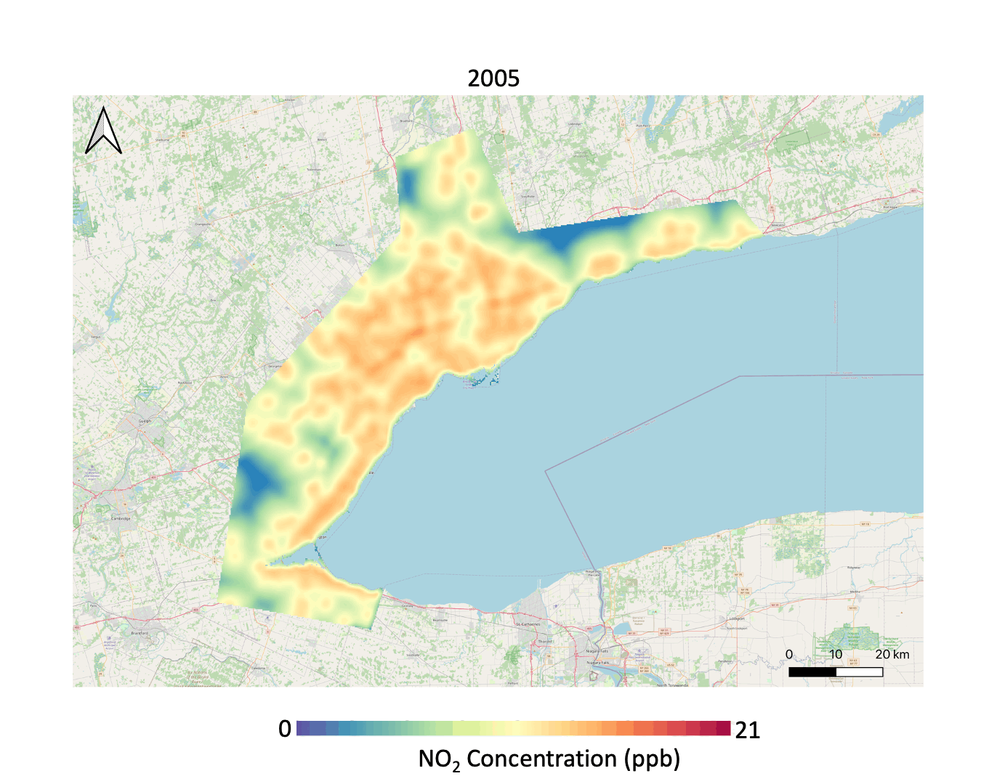
Air Quality and Health: CANUE (New data source!)
New Data
Challenge in science to combine and use together the increasing volumes of available data!
New Canadian Urban Environmental Health Research Consortium (CANUE) dataset.
  Effort led by Jeff Brook (UofT Dalla Lana School of Public Health, retired from ECCC AQRD)
    Support provided by ECCC mainly through Shailesh Kharol
  Publicly available data portal containing many environmental factors linked to health outcomes:
    Traffic density, local air quality, greenspaces, noise and light pollution
  Countless potential applications for this new data source:
    Trend in air pollution (traffic) across the Greater Toronto and Hamilton Area (GTHA)
      Insights on exposure levels can help link to health risks
      Pollution control efforts leading to decreasing trends in NO₂ in the GTHA is a good news story!
    Planning healthy cities and towns HealthyDesign.City
Unprecedented public access to combined air quality and health outcome data!
Sources: https://canue.ca/ and https://healthydesign.city/
https://www.dlsph.utoronto.ca/2023/06/02/dlsph-researchers-map-gtha-traffic-air-pollution-and-its-changes-over-the-last-15-years/
Notes:
RES: Research Scientist
AQRD: Air Quality Research Division
Mapping the 30-meter distribution of NO2 using data from 13 monitoring sites along with wind speed, road networks, industry, land use, and other features (future integrate satellite data into land use regression)
Elevated levels in downtown cores and 400 series highways (traffic density)
GTHA: Greater Toronto and Hamilton Area

Slide 13
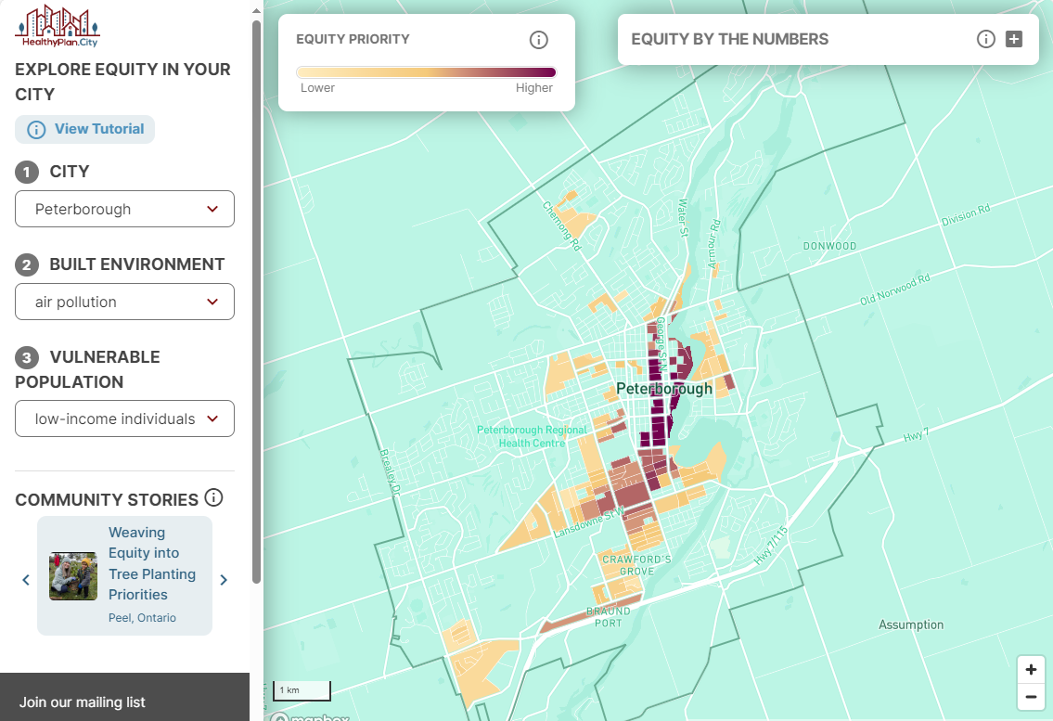
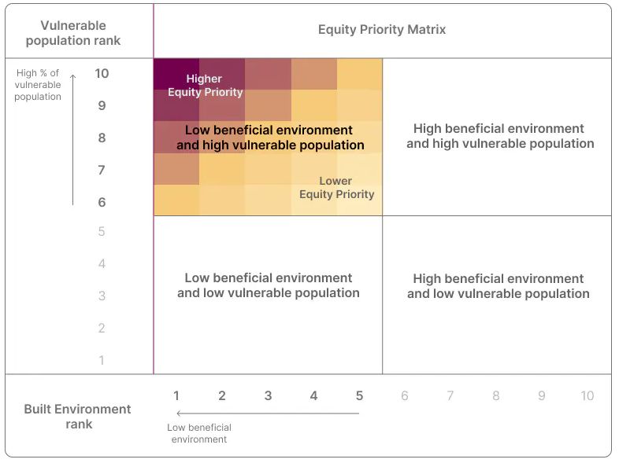
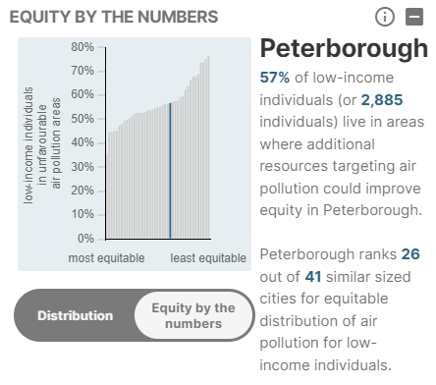


Air Quality and Health: HealthyPlan.City
New Application
Developed by the University of Toronto
Combining
Combining air quality data with socio-economic information (e.g. low-income) to provide additional insights on inequity across a city.
Identifies areas in the city where additional air pollution reduction efforts would improve equity for low-income individuals.
Used to help inform city planners
Source: https://healthydesign.city/
Nice new tool to identify where resources targeting air pollution could improve equity within a city.

Slide 14
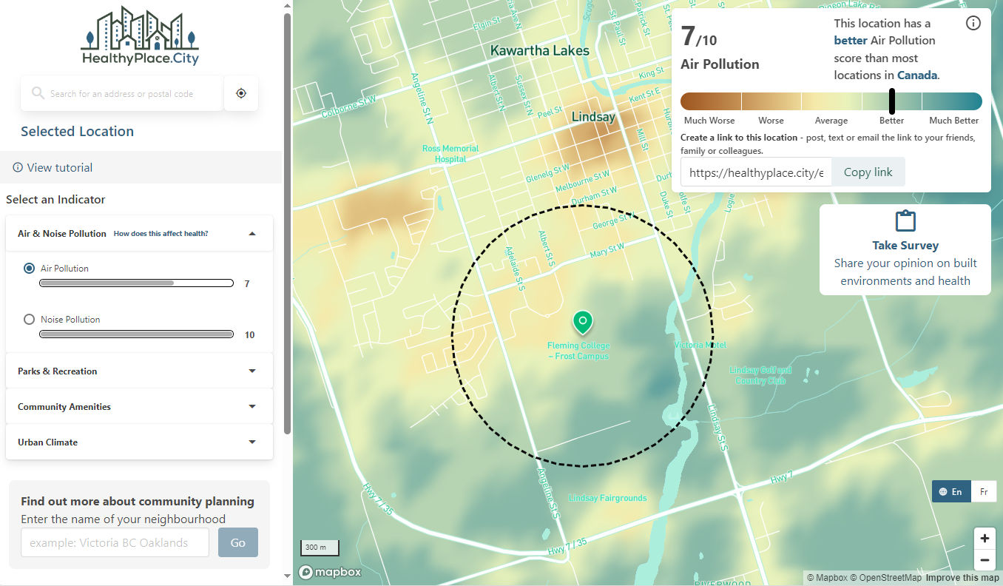
Air Quality and Health: HealthyPlace.City
New Application
Developed by the University of Toronto
Lindsay downtown score of 3/10 (worse than most locations)
Tool assigns scores for multiple health-related built environment factors in communities (>1000 persons & 400 people / km²) across Canada
Low score (e.g. high air pollution, less access to parks)
High score (e.g. low air pollution, good access to parks)
New tool to explore how different locations in cities across Canada compare to each other for a range of different health-relevant urban indicators.
Fleming College Frost score of 7/10 is better than most locations across Canada
Sources: https://healthyplace.city/

Slide 15
ECCC Air quality research and applications examples:
Emissions inventories and air quality modelling

Slide 16
Emissions Preparation for Air Quality Modelling/Forecasts
Emissions are one of the key inputs to the air quality modeling (forecasting)
National pollutant Release Inventory (NPRI)
Created in 1992 to support a wide range of environmental initiatives, including air pollution prevention and abatement activities
For specific AQ forecast modelling purposes these facility reported emissions are allocated to model grid based on the location of the NPRI facilities.
EPA’s Emission Modeling Platforms
US and Mexican national inventories
National Emissions
Used in ECCC North American AQ Modelling/Forecasts
Air Pollutant Emissions Inventory (APEI)
ECCC’s Canadian national inventory
ECCC in-house area and mobile source emissions
Area and mobile emissions are allocated to model grid using spatial surrogates (e.g. allocating on-road refuel emissions based on the locations of gas stations)
Provided by : Inputs from Dr Junhua Zhang (ECCC)

Slide 17
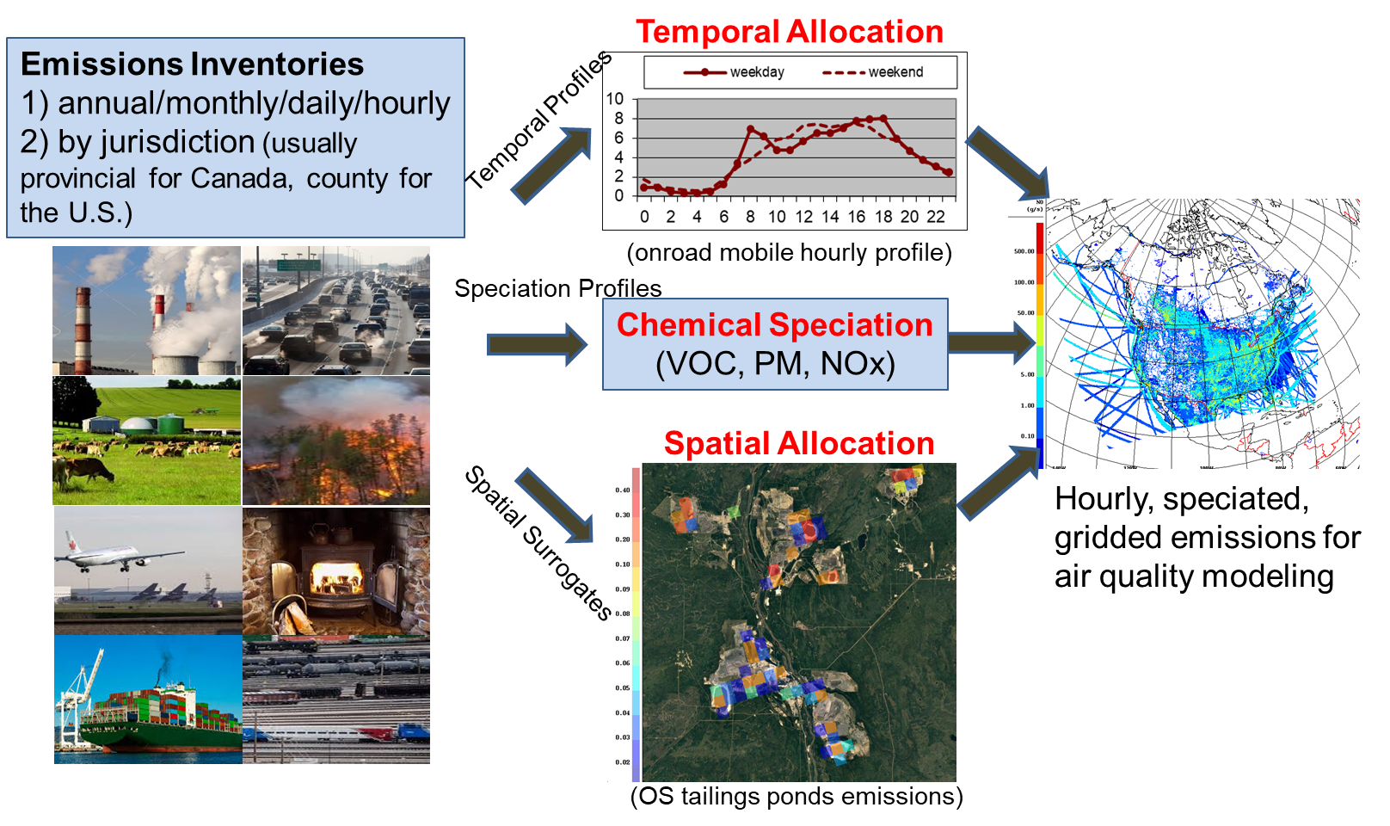
Emissions Preparation for Air Quality Modelling/Forecasts
Inputs
Emission Processing Steps
Gridded Model Emissions
Provided by : Dr Junhua Zhang (ECCC)

Slide 18
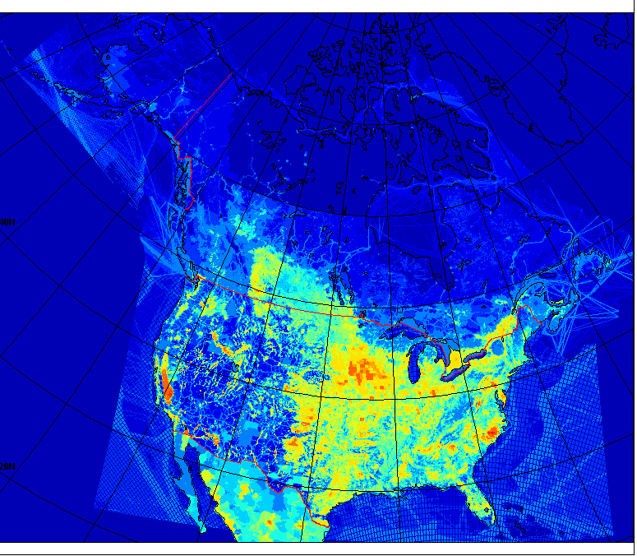
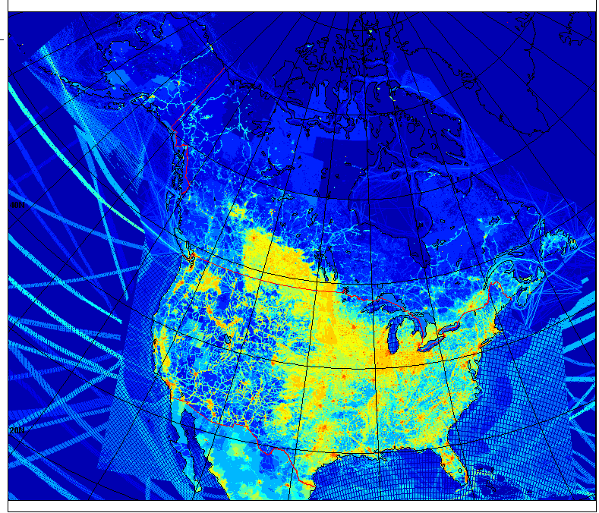
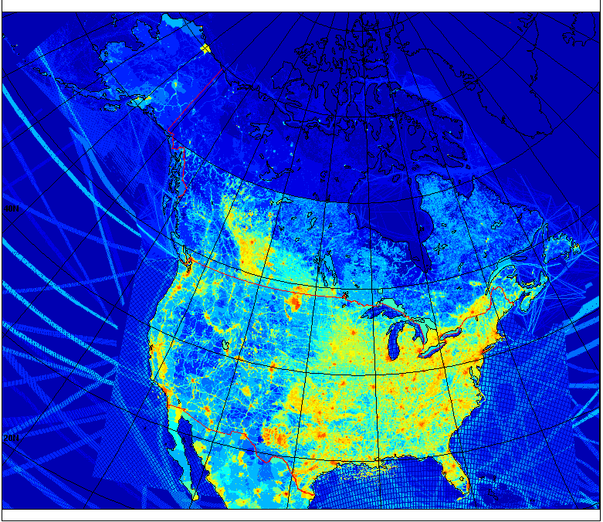
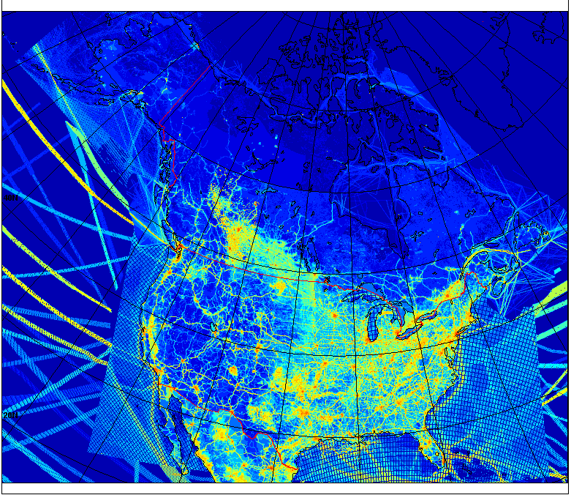
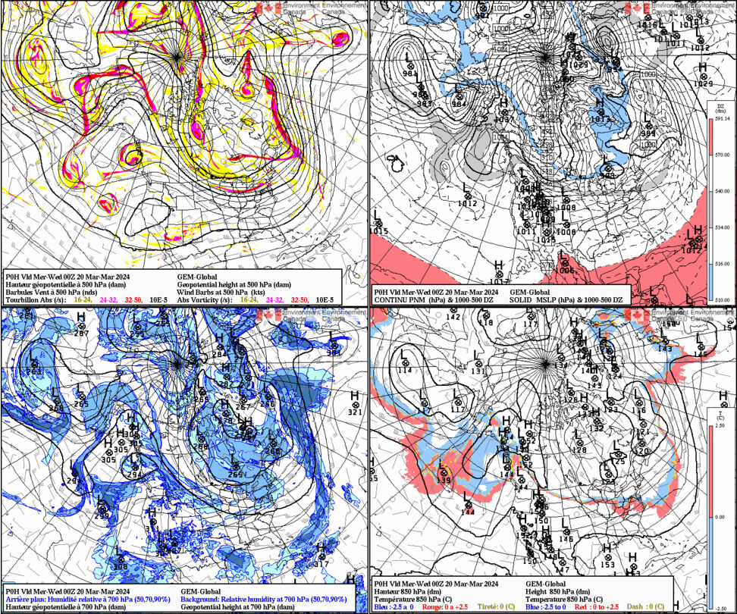
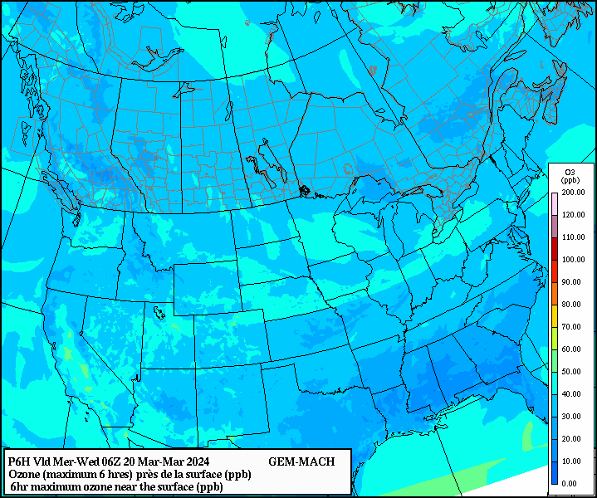
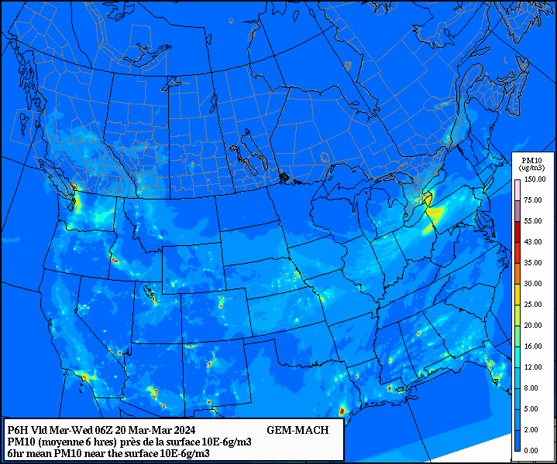
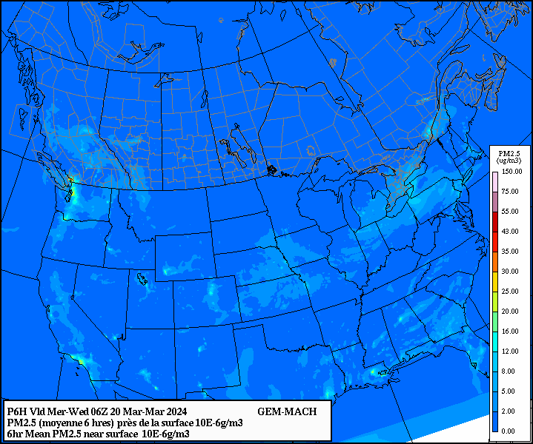
A Simplified Schematic of ECCC’s Air Quality Model (GEM-MACH)
Input Emissions
Divide atmosphere into discrete boxes, group vertical columns of boxes into slices
Emissions
Dynamics
Deposition
Physics
Chemistry
Initial Conditions
Increment Timestep
Send each slice of the atmosphere to a node on the supercomputer
Model outputs
Provided by : Dr Colin Lee (ECCC)

Slide 19
Example of ECCC AQ Model Output: 3-day Forecast of Surface PM_{2.5}
GEM-MACH surface fine PM_{2.5} forecast
Gridded forecast of model simulated PM_{2.5} concentrations at 10 km spatial resolution.
6-hour interval steps forecasted out for 3 days
Publicly available at ECCC:
Regional Air Quality Deterministic Prediction System (RAQDPS) - Environment Canada (weather.gc.ca)
Provided by : Dr Colin Lee (ECCC)

Slide 20
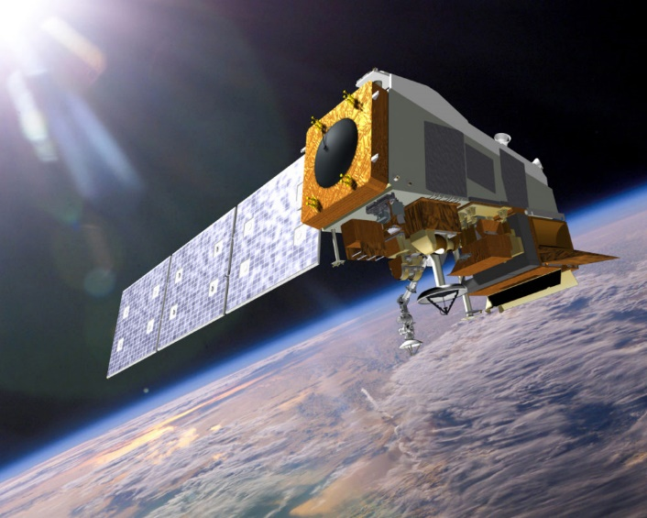
ECCC Air Quality Research and Applications Examples:
Satellite Remote Sensing of Air Pollution
Satellite observations can help address some air quality questions like:
  How do pollutants vary in space and time?
  Where are the pollutants coming from and how much is being emitted?
  Where do they end up (transport)?

Slide 21
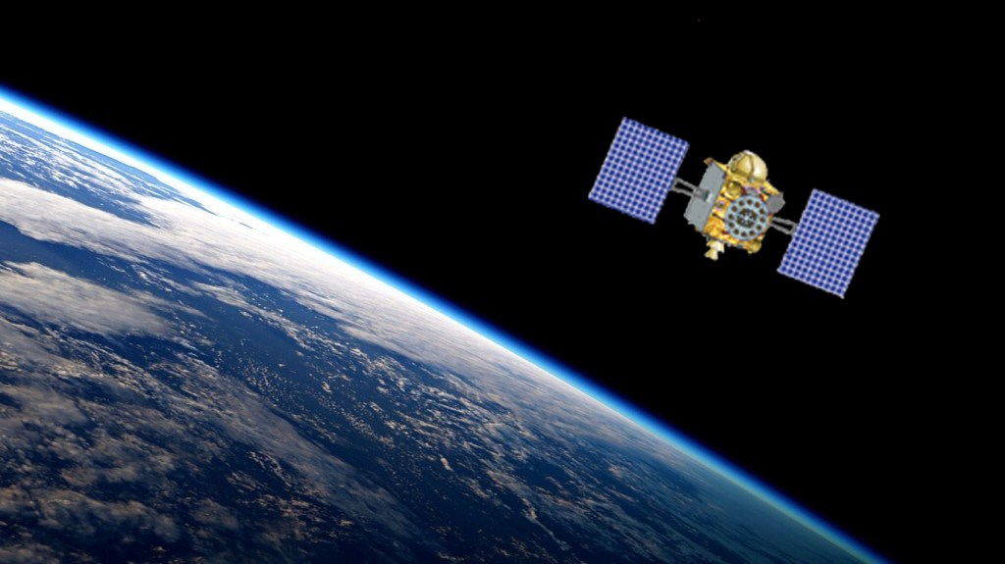
General satellite remote sensing measurement principle
Three general categories:
Passive solar backscatter – UV/visible/near-IR
Passive thermal emission
Active backscatter
Remote sensing is obtaining information about an object from a distance.
These instruments do not directly “measure” atmospheric composition, but it is inferred through an analysis of the measured electromagnetic radiation.
Source: Provided by Chris McLinden (ECCC)

Slide 22
General satellite remote sensing measurement principle
Electromagnetic spectrum is simply the full range of frequencies that characterizes the solar radiation.
For air quality purposes we use only a small portion of the spectrum that is sensitive to atmospheric composition (Infrared, Visible, an UV).
Different atmospheric pollutants reflect and absorb at different wavelengths in the spectrum creating “spectral signatures”
These spectral signatures measured by a satellite are used to determine the atmosphere composition (e.g. type and amount of pollutant).
Source: https://appliedsciences.nasa.gov/sites/default/files/2023-02/Fundamentals_of_RS.pdf

Slide 23
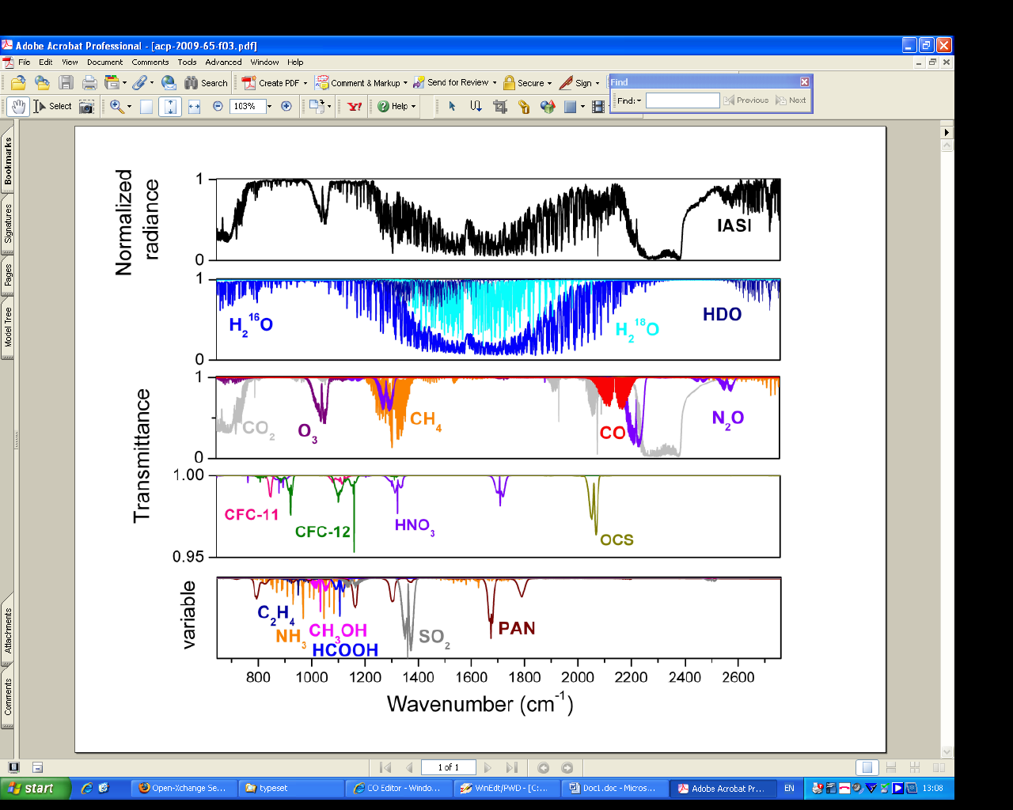
General satellite observations (often called retrievals)
Satellite Spectral Signatures
Retrieval Algorithm
(Radiative transfer modelling and other ancillary information)
Geophysical Parameters
(e.g. pollutant concentrations)
Research and Applications
(Monitoring, Trends, AQ Model Evaluations, Emissions, Deposition
CH₄
Satellite Ammonia Observations
(Lethbridge, AB, Canada)
Satellite and inventory emissions
(Lethbridge, AB, Canada)
H₂O
CO₂
O₃
CO
CO₂
Satellite
Inventories
Evaluate traditional emission inventories with satellite-derived emissions.

Slide 24
Satellite remote sensing of atmospheric composition
Strengths
Provides global spatiotemporal coverage
Fill in monitoring gaps (e.g. remote and otherwise inaccessible locations, developing world)
Datasets can be re-processed as algorithms are improved
  – single approach applied everywhere
Ideal for detecting or tracking source/deposition locations
Datasets with decadal time series allow for trend analysis and tracking of mitigation efforts
Weaknesses
Not all near surface pollutants of interest can be observed
Temporal coverage is not continuous (generally 1-2 measurement per day)
        - only under cloud-free conditions
Limited vertical resolution (more of a vertically integrated type of observation (e.g. total columns))
Spatial resolution on the order of ~5-10km
Individual observations are generally, less precise than conventional monitoring
Satellite observations should be viewed as complementary to conventional monitoring!
24

Slide 25
ECCC Air Quality Research and Applications
Satellite observations of world trends in CACs
(e.g. SO₂, NO₂, PM_{2.5}, NH₃)
How are these pollutant levels changing in time?

Slide 26
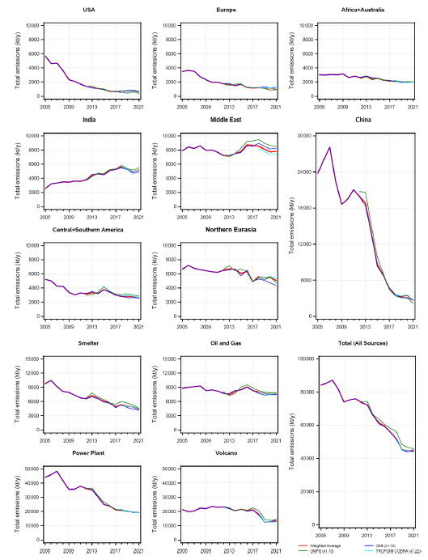
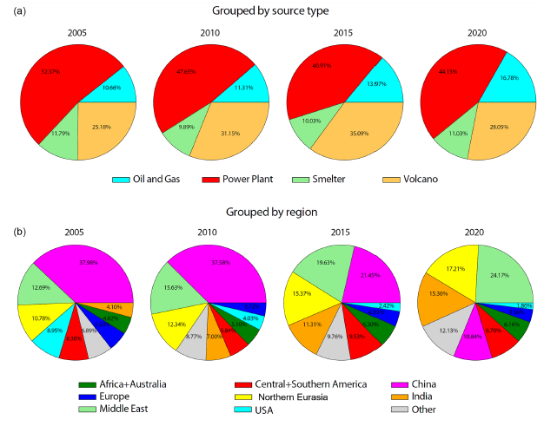
Satellite-derived world trends in SO₂ emissions (2005-2021)
New Results
ECCC AQRD led effort to catalogue continuously emitting large (~10 kt/yr to more than 4000 kt/yr) SO2 point sources
  Used to improve emission inventories for air quality and climate models
  Monitor emissions (e.g. reductions efforts from sulfur-capturing devices)
Oil and Gas contribution more constant
Power plants are the main contributors (44%)
Oil and Gas contribute (16%)
Source Type
Most sources are declining significantly
Global ↓50%
Volcanoes contribute 28%
# Large Sources: (102) (477) (74) (106)
Smelters contribute (11%)
Regions with large decrease
Anthropogenic emissions grouped by region
Middle East now with the largest total contribution 24%
Regions
Emissions form India are increasing
Leveling off in recent years
Surpassed China now with 15%
China went from ~40% to 11% of the world total
~50% decline in global sulfur dioxide emissions between 2005 and 2021, although more stable during the last 3 years
Sources: Vitali Fioletov, Chris McLinden, Debora Griffin et al., 2023: https://essd.copernicus.org/articles/15/75/2023/essd-15-75-2023.pdf
Catalogue available at https://doi.org/10.5067/MEASURES/SO2/DATA406,

Slide 27
Satellite-derived world trends in urban NO₂ (2005 – 2019)
Ratio of annual averaged satellite column amounts
Aggregated Globally
Looking at 80 urban megacities worldwide
OMI satellite-based estimates (black lines)
  Colour lines are different emission inventories
General decreasing trend globally ~3.5% / yr starting from 2009.
  Overall ~-30% decrease (2006-2018)
Decreasing Increasing
Large decreasing trends and early adopters of stringent policies (-30 to -50%)
Satellite trends of urban cities group into regions
US-Canada↓50%
General decreasing trend in urban NO₂ emissions globally due to pollution controls on vehicles and power plants.
China Large drop near end of period
Flat or small increasing trends (~0 to 10%)
Sources: Goldberg et al., 2021: Urban NO x emissions around the world declined faster than anticipated between 2005 and 2019 https://iopscience.iop.org/article/10.1088/1748-9326/ac2c34/meta; https://airquality.gsfc.nasa.gov/no2
Notes:
Some regional inventories (colour lines) compare well satellite-derived emissions (e.g. North America, Europe) and some need work (e.g. China, Latin America)

Slide 28
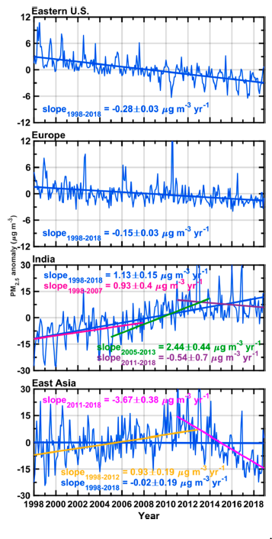
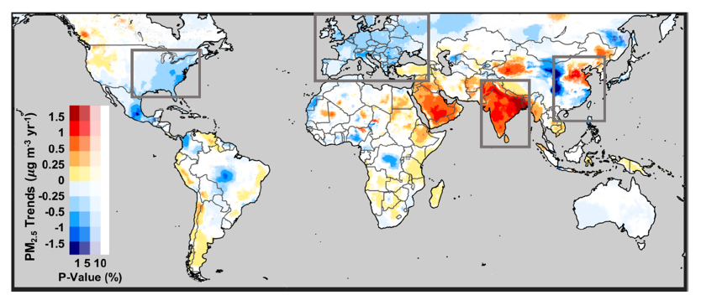
Satellite-derived world trends in PM2.5 concentrations (1998-2018)
Originally developed in Canada at Dalhousie University, now available at Washington University
Currently researching and developing a new ECCC satellite-derived PM_{2.5} global product, like this product from Washington University, but incorporating machine learning and ECCC AQ model
Trends in PM2.5 over the 21-year period (combining satellite, surface, and model data)
Some regions are decreasing
  Eastern US :-0.28 μg/m³/yr
  Europe: -0.15 μg/m³/yr
Decreasing
Some regions are increasing
  India: 1.13 (2005-2013) μg/m³/yr
    Flatting in recent trend
  Middle East, Central Africa, and Canada (forest fires?): 0.25 to 0.5 μg/m³/yr
Increasing
Different trends in different regions
Large decreasing trend over China later in period
  China: -3.67 μg/m³/yr (2011 - 2018)
Globally there is a small increasing trend of 0.04 μg/m³/yr
Overall: PM_{2.5} has strong regional trends, not much of an overall global trend
Sources: Hammer et al., 2020: https://pubs.acs.org/doi/10.1021/acs.est.0c01764
Notes:
Canada: Forest fires near the end of the trend?

Slide 29
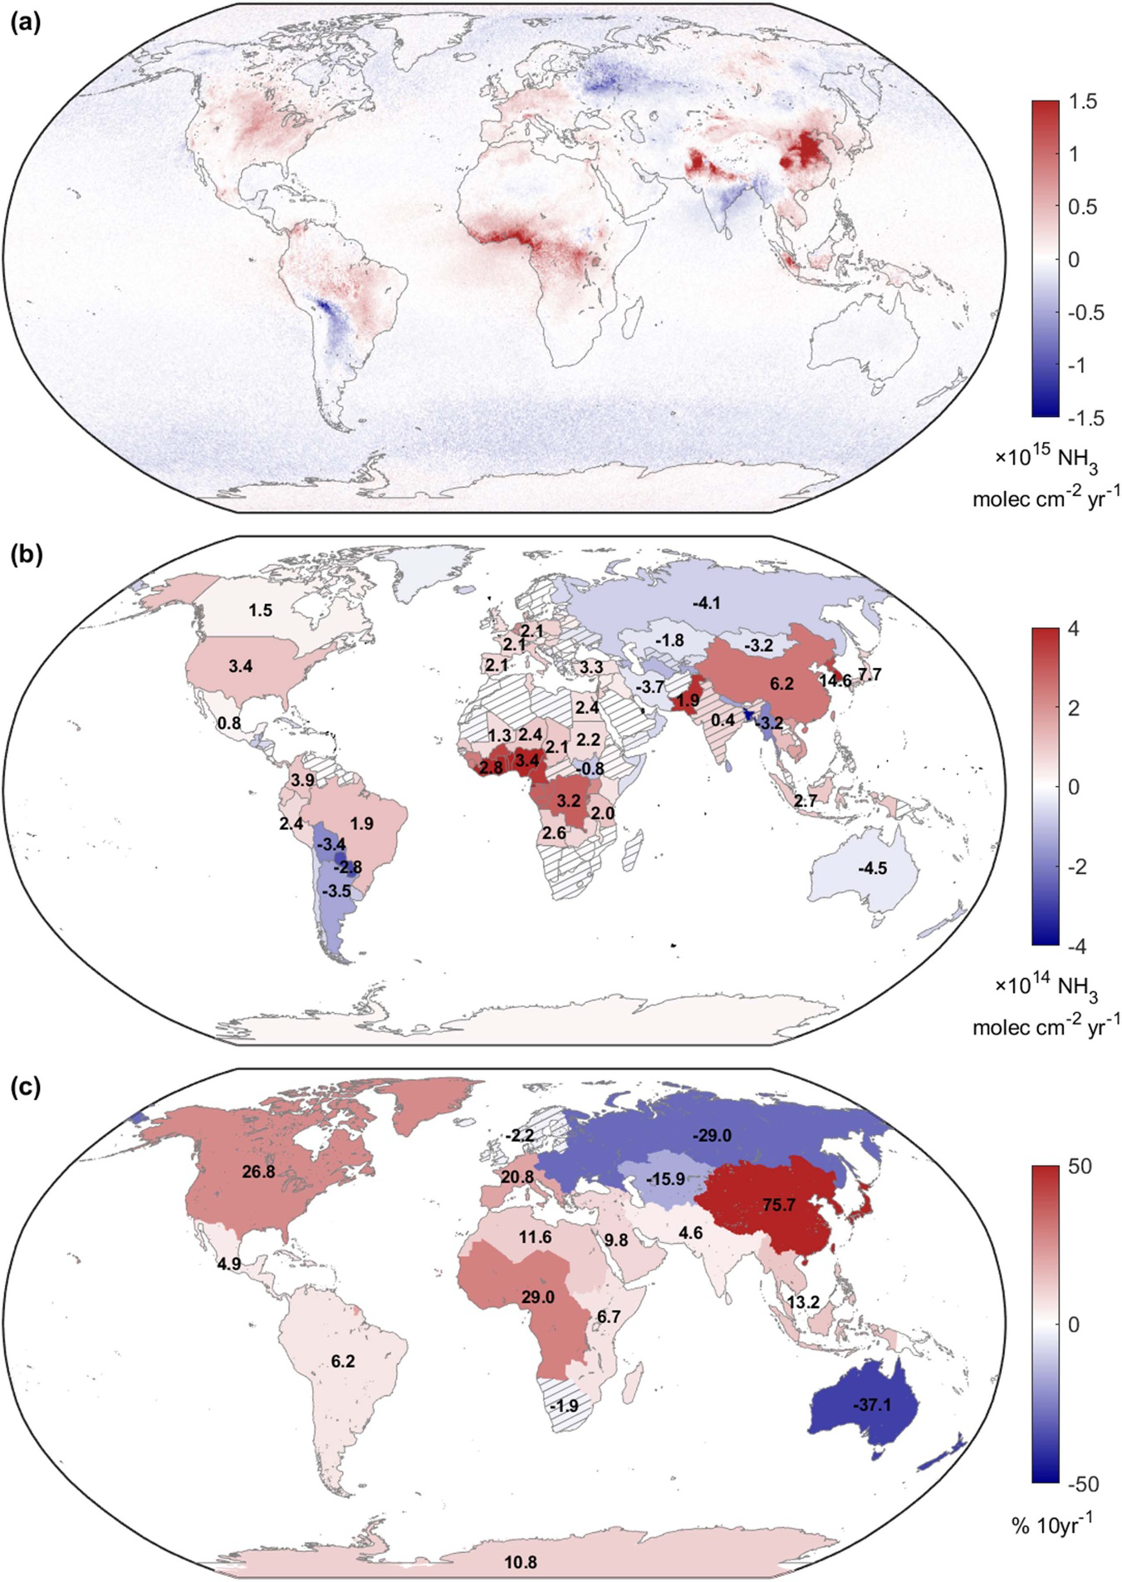
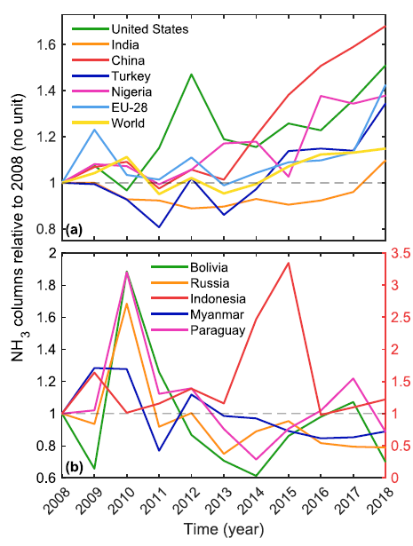
Satellite-derived world trends in ammonia (2008 - 2018)
Trends in Ammonia
Yearly time series relative to 2008
General increase in world NH₃ concentrations shown in satellite observations since ~2013
0.5 x 0.5 deg grid
Regional differences:
  Increases in North America(2.5%/yr), EU-28(2.0%/yr), China(7.5%/yr), etc.
  Decreases in Russia(-3%/yr), Australia(-4%/yr), etc.
national scale
Increasing trends driven by increasing demands on food production to feed an increasing world population
More livestock production
Greater use of fertilizer for crops
Ammonia is the only main CAC pollutant that is currently increasing globally
regional %/10yr
Counties and regions with non-significant trends have been hatched
Source: Van Damme et al. 2021, https://iopscience.iop.org/article/10.1088/1748-9326/abd5e0

Slide 30
Example ECCC Research and Application Project:
Gaining insights on atmospheric ammonia through ECCC produced satellite observations

Slide 31
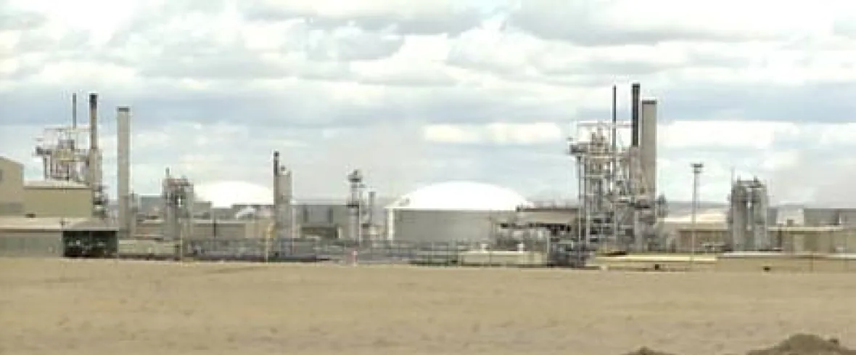
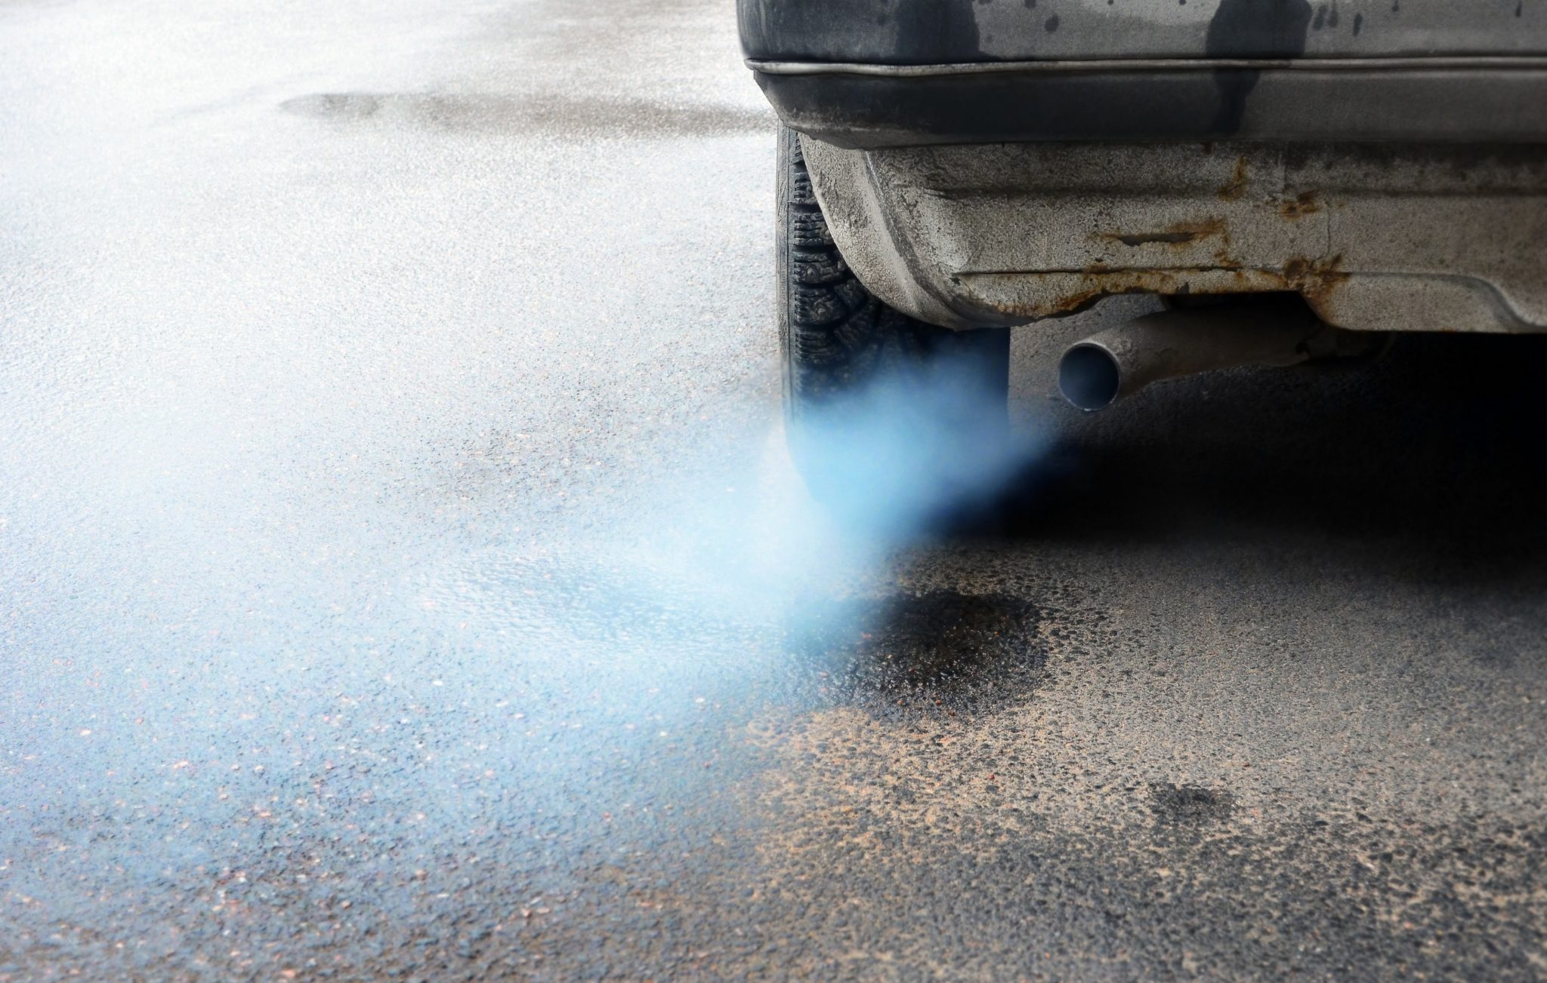

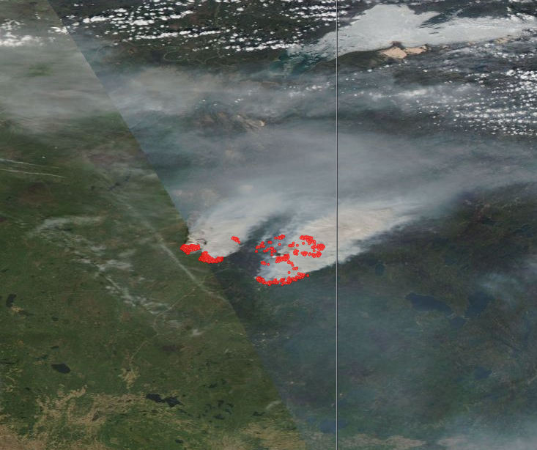
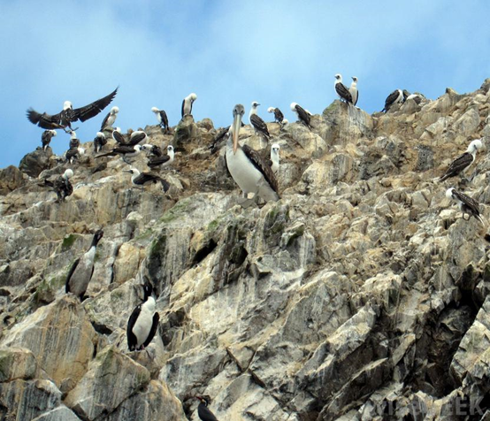
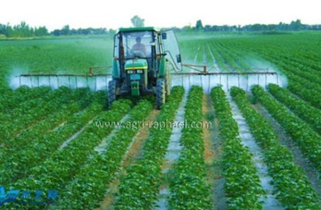
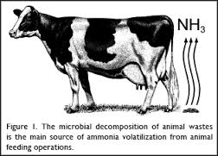
Ammonia (NH₃) emission sources
Industry
Fertilizer production
point sources
Automobiles
Catalytic converters
Large urban centers
Canada's largest nitrogen fertilizer manufacturing facility in Medicine Hat, Alberta (www.cbc.ca)
https://ie.unc.edu/
Biomass burning
Wildfires
Crop burning
Natural
Decaying vegetation
Wild bird waste
EOSDIS Worldview
Fort McMurray, Alberta wildfires May 16, 2016.
AGRICULTURE
Animal waste
Crop fertilizer application
Publications and Educational Resources – Virginia Tech

Slide 32
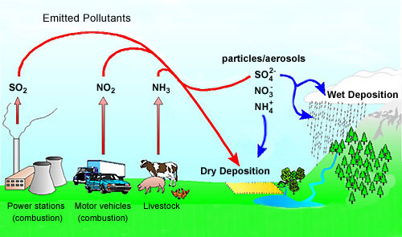
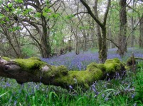
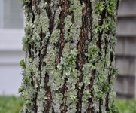
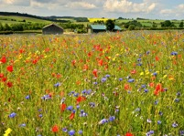
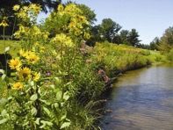
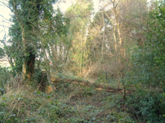
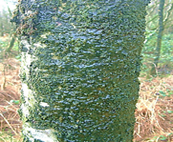
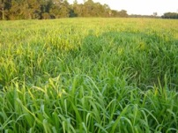

Why are we interested in ammonia (NH₃)?
Air, Soil, and Water Quality
Ammonia is an important precursor to the secondary production
of fine particulate matter (PM_{2.5}); a key contributor to smog
  PM_{2.5} associated with increased risk of cardiovascular and respiratory diseases
    Input into the Canadian Air Quality Health Index (AQHI)
Ammonia as a source of reactive nitrogen deposition
  Ammonia is one of the most important reactive nitrogen species
  Excess reactive nitrogen deposition from ammonia leads to:
    soil acidification
    eutrophication (e.g. algal blooms)
    biodiversity loss
PM_{2.5}
Soil Acidification
Water Eutrophication
Semi-natural ecosystems
biodiverse forest lichens biodiverse grasslands pristine water
Nitrogen-excessive ecosystems
forest biodiversity loss lichen specie monoculture grasslands algal blooms

Slide 33

Spatiotemporal patterns in ammonia: Multi-year “Climatology”
ECCC Cross-Track Infrared Sounder (CrIS) satellite observations
Lethbridge, AB
Wash. St.
Idaho
N. Carolina
Central Valley
US Mid-West
Use satellite observations providing insights on the spatial distribution of ammonia hotspots
Dataset publicly available from ECCC: https://hpfx.collab.science.gc.ca/~mas001/satellite_ext/cris/snpp/nh3/v1_6_4

Slide 34

Spatiotemporal patterns of ammonia: Interannual variability (2013-2020)
ECCC Cross-Track Infrared Sounder (CrIS) NH₃ satellite observations
Interannual variability of ammonia
General overall increasing trend in NH₃ concentrations over this period
Still see the impact of large wildfire events in the annual means at northern non-agricultural latitudes
e.g. Great Slave Lake, NWT in 2014
(Click here to view movie)

Slide 35

Spatiotemporal patterns of ammonia: Monthly Variability
ECCC Cross-Track Infrared Sounder (CrIS) NH₃ satellite observations
See the typical seasonal pattern of ammonia
Lack of NH₃ in cold season at northern latitudes
General springtime peak at start of growing season from fertilizer applications
Large episodic wildfire events in non-agricultural regions (e.g. northern latitudes) still impact a 9-year monthly average in the summer months (July and August)
(Click here to view movie)

Slide 36




Satellite ammonia observations over animal feedlots
Large number of concentrated animal feedlot operations (CAFO) of cattle near Lethbridge, AB, Canada.
0.8 km

Slide 37











ECCC satellite ammonia (NH₃) applications
Mapping and Monitoring
Shephard, et al., AMT, 2020; Kharol, Shephard, et al., preparation, 2024
Satellite-derived Dry Deposition
Kharol, Shephard, McLinden, et al., GRL, 2019
Air Quality Model Evaluations
Shephard, Dammers, et al., AMT, 2020
Satellite and Surface Observations
CAPMoN
Emissions
Satellite
Longwoods, Ontario, Canada
Ground
GEM-MACH
Surface NH3
Surface Site
Ratio: NO₂ / (NH₃ + NO₂) Dry Deposition Flux
Satellite
Surface NH3
(2012-2021)
July & August 2016
Satellite-derived NH₃ Emissions
Dammers, Shephard, Griffin, et al., in preparation, 2024
Chemical Data Assimilation
Sitwell, Shephard, Rochon et al., ACP, 2022
County-level Annual Anthropogenic Emissions
Wildfire Emissions
GEM-MACH NH₃ Inversions
Original New Inversion Differences
Satellite-derived (“Top-down”)
Traditional Inventory (“Bottom-up”)
Fort McMurray, Alberta, May 2016
CrIS Satellite
May 16 2016
EOSDIS Worldview
Total NH₃ Emissions Fort McMurray, Alberta 2016
Satellites
Fire Models
Anthropogenic
Adams, McLinden, Shephard, ACP, 2019
Notes:
CrIS: Cross-track Infrared Sounder
AAFC: Agriculture and Agri-Food Canada
EPA: Environmental Protection Agency
AER: Atmospheric and Environmental Research, Inc. (Boston, MA, USA)
TNO: Netherlands Organization for Applied Scientific Research (TNO), (Utrecht, Netherlands).
AQ: Air Quality

Slide 38
Summary: A small taste of some of the air quality research and applications that are used to help improve the health and well-being of Canadians.
Thanks
Contact: Mark.Shephard@ec.gc.ca

Slide 39
Background Slides

Slide 40
Typical Satellite Orbits
Low Earth Orbit (LEO) : e.g. Polar Orbit
Sun synchronous orbit at ~800 km elevation rotating around the earth every ~100 mins passing close to the North and South poles with overpasses at similar local solar time each day
Most have full global coverage (often daily)
Geostationary Orbit (GEO)
Orbit is at ~36,000 km elevation above the equator, rotating with the Earth
Only have coverage over the same hemisphere
Typically provide hourly hemispheric coverage
Source:Source: Gupta, P.; Follette-Cook, M.; Strode, S.; Malings, C. (2023). https://appliedsciences.nasa.gov/sites/default/files/2023-03/D1P1_RS_v2_PG_JO.pdf

Slide 41



Ammonia trends and future projections
ECCC’s Air Pollutant Emission Inventory (APEI)
24%
Historical Trends
  NH₃ has been increasing in Canada and globally
  Other PM_{2.5} precursors such as SO_{x}, NO_{X} that have been generally decreasing due to increased controls
    Catalytic converters in vehicles (NO_{x})
    Flue-gas desulfurization devices installed in power plant stacks (SO_{x})
Future Projections
  Global and Canadian ammonia (NH₃) emissions are forecast to increase:
    Increasing demands on food production to feed an increasing world population
      More livestock production
      Greater use of fertilizer
Crop
Livestock
1990
2020
2.5
2.0
1.5
1.0
0.5
0
Emissions (Tg/yr)
Canada-USA Transboundary Particulate Matter Science Assessment, 2013
IPCC Emission Scenarios
Ammonia (NH₃) is the only main PM_{2.5} precursor that is both currently increasing and expected to continue to increase in the future
Notes:
ECCC’s Air Pollution Emission Inventory (APEI)

Slide 42







Industrial point source emissions of NH₃ (e.g. fertilizer plants)
Donaldsonville ammonia, United States [IASI-A, 2013-2018]
Industry point source emissions
  ~3% of Canada’s, and ~1.5% of the US’s total national emissions
Examples where satellite-derived emissions:
  Agree well with inventories for some locations,
  Are completely missing in the current inventories
Used satellite-derived emissions to help identify missing point sources and help evaluate other industrial emissions
Satellites
Inventories
TogliattiAzot, Russia [CrIS, 2013-2018]
Satellites
Inventories
Notes:
Combine satellite observations with wind information. Weaker sources need to combine many observations (annual), which is done using wind rotation to orientate observations in an upwind and downwind plume. Then these observations are fit with a gaussian plume model to obtain emissions and lifetimes.
HTAPv2: Hemispheric Transport of Air Pollutants
NEI: National Emissions Inventory (US EPA)
E-PRTR: European Pollutant Release and Transfer Register

Slide 43

Satellite-derived NH₃ wildfire emission example
Satellite (MODIS) image of smoke and hotspots
May 16 2016
Emissions: mass / time
Mass in the box
Satellite Column Density x Area x MolecMass
Rate mass leaves box
Winds from Weather Prediction Model
EOSDIS Worldview
Total Emissions
Fire Emission Models:
ECMWF Global Fire Assimilation System (GFAS)
Fireworks: ECCC Fireworks model
Emission Inventory:
ECCC Air Pollutant Emissions Inventory (APEI)
Satellites
Models
Anthropogenic
Satellite and fire emission models agree pretty well for these Fort McMurray, Alberta fires
Total Fort McMurray fire emissions are significant compared with anthropogenic
  magnitude of ~20% of Alberta’s total annual anthropogenic emissions

Slide 44



Decadal trends in ammonia concentrations across North America
US AMoN Sites
Canadian NAPS Sites
Generally increasing trend in ammonia over NA (past decade ~2008 to 2018)
Potential factors influencing increasing trends in ammonia concentrations
  Increase in ammonia emissions
  Changes in the chemical conversion to PM_{2.5} due to changes in SO₂ and NO_{x}
  Changing meteorology (e.g. temperature (volatilization rates))
Often multiple factors work together, but sometimes one factor can dominate
Increasing trend is consistent with regional and global satellite observations
Provided by Leiming Zhang

Slide 45

Plume model and fitting (inversion)
Plume model assumes concentrations emitted from a point source decline exponentially in time and affected by turbulent diffusion that can be described by a 2D Gaussian function allowing for:
  1. Simple first-order loss (chemical transformations and deposition)
  2. Coarse spatial resolution (a smeared view by the satellite)

