Slide 1
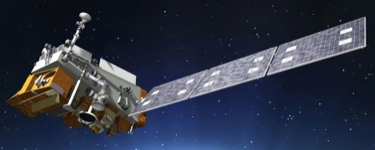
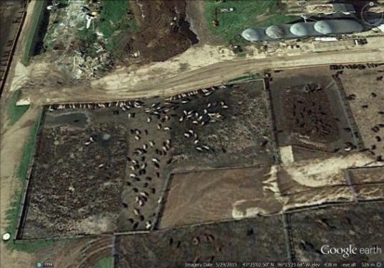
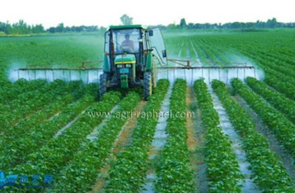
Cross-Track Infrared Sounder (CrIS) satellite observations of ammonia:
Updates with initial application examples
Presenter: Mark Shephard
Environment and Climate Change Canada
Air Quality Research Division
EGU General Assembly
Vienna, Austria,
April 9th, 2019
Presentation: 18436

Slide 2
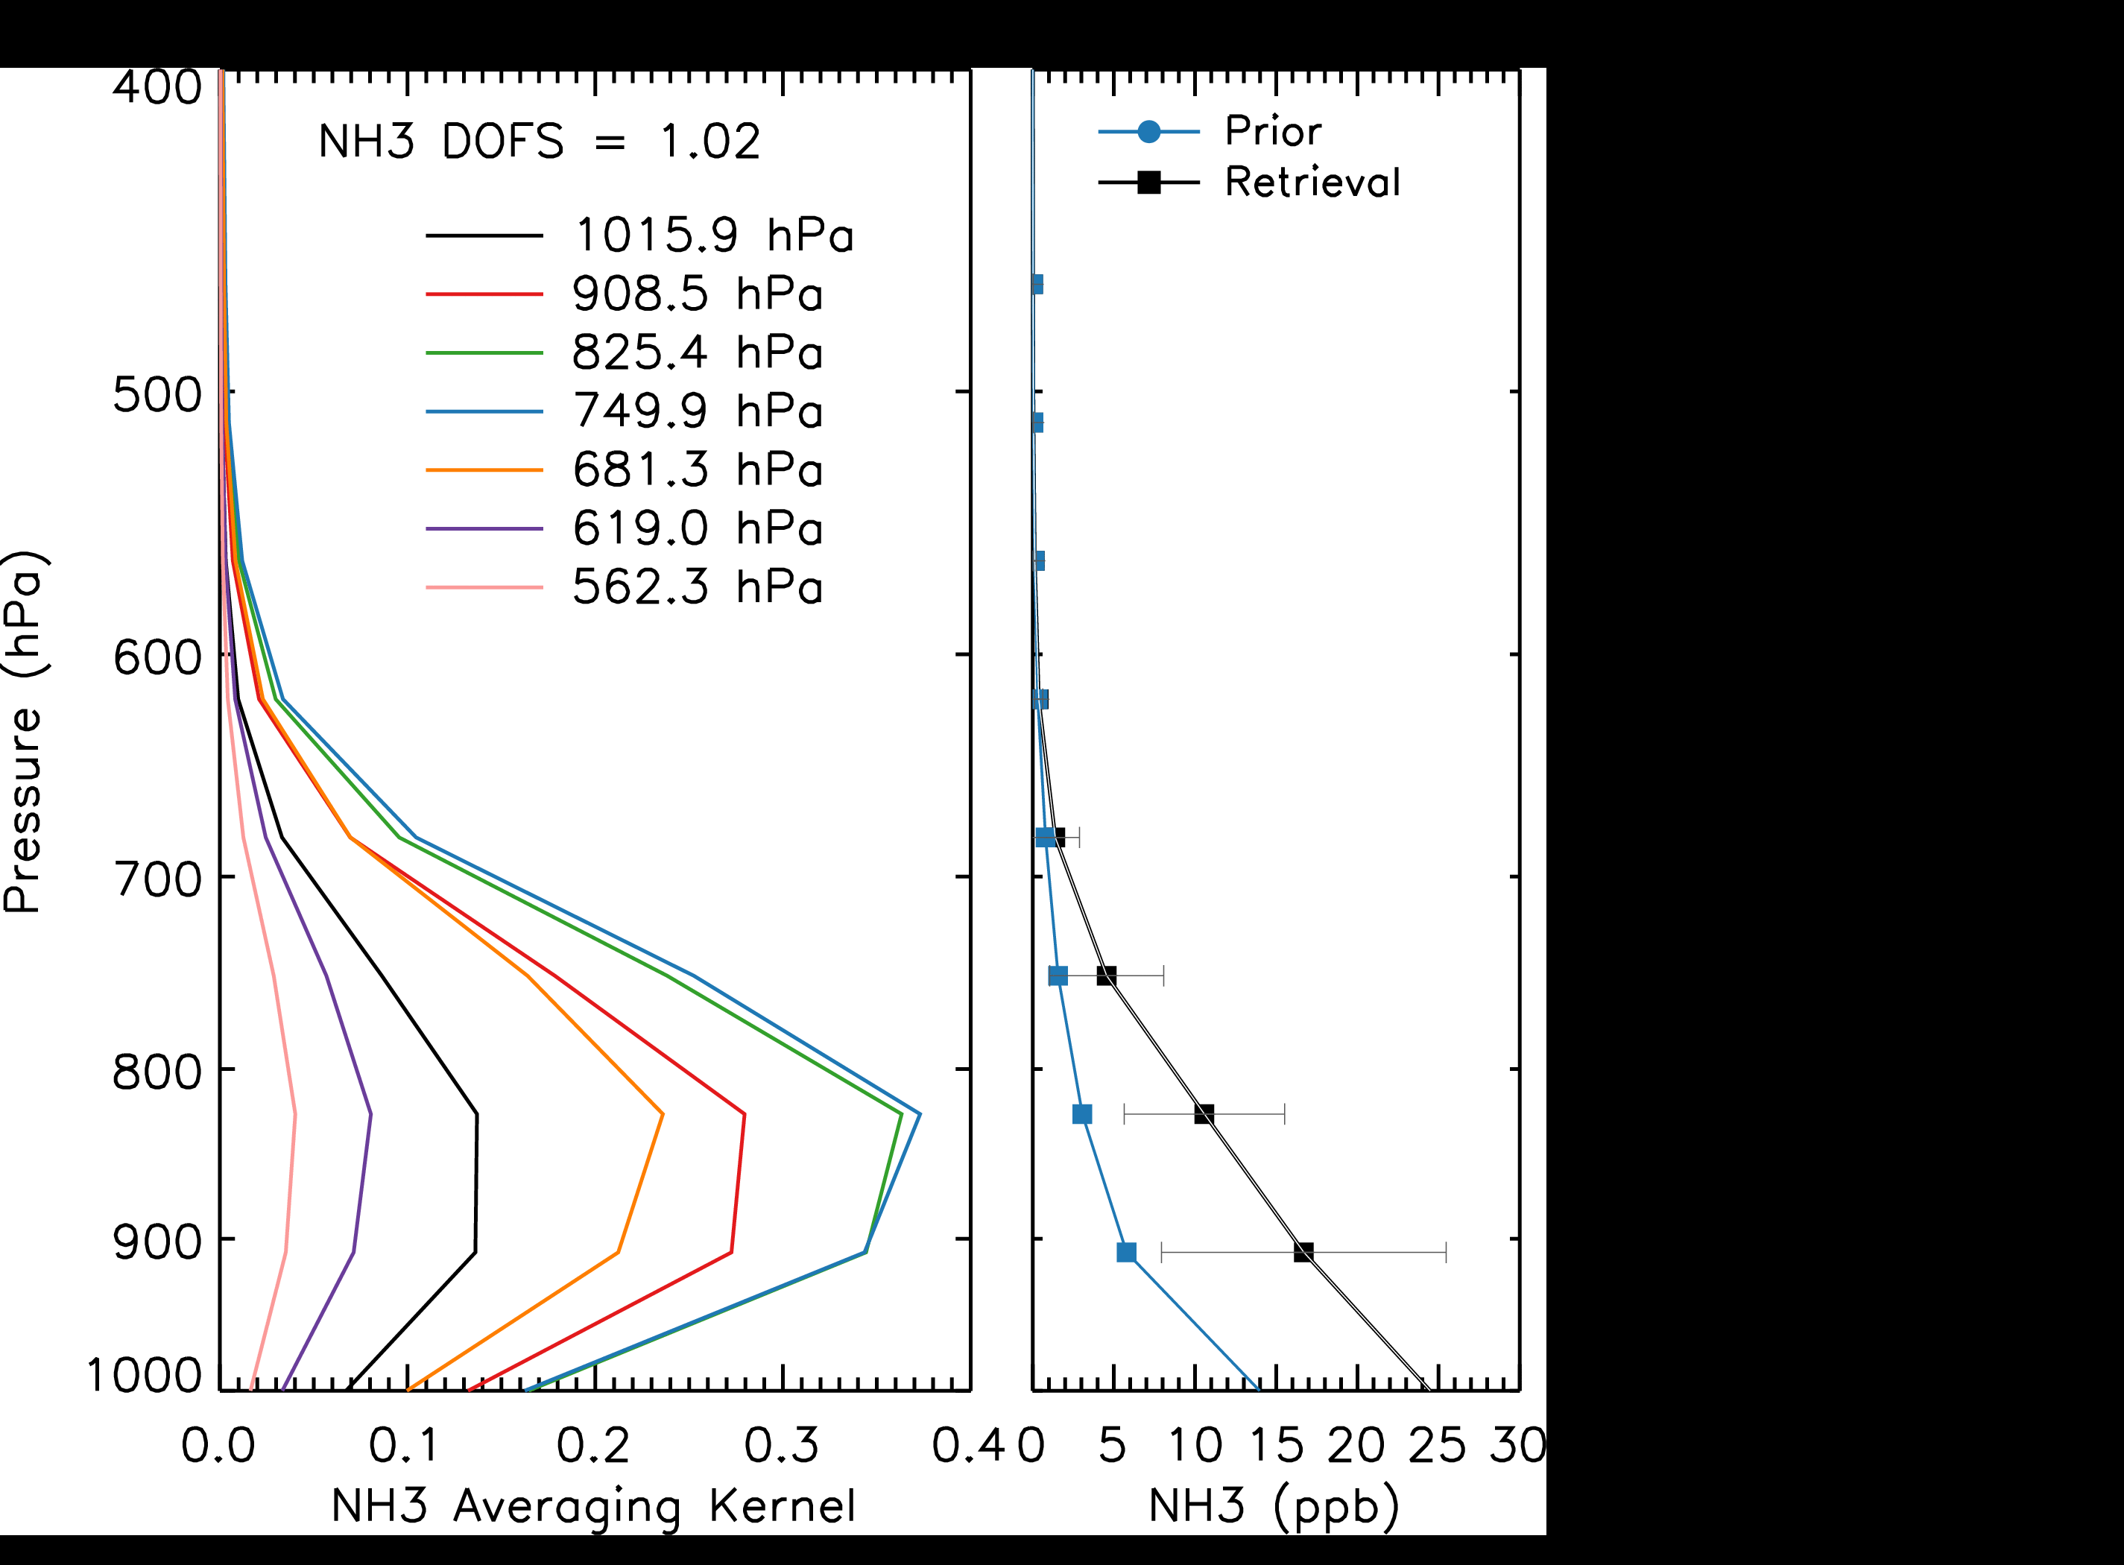
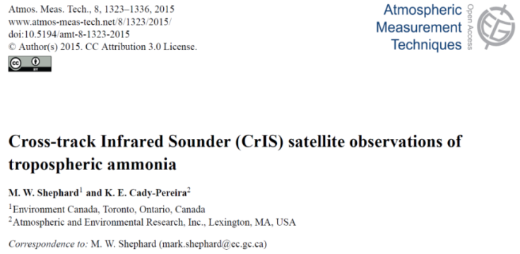

Cross-track Infrared Sounder (CrIS) Satellite
  NASA/NOAA CrIS instrument measures upwelling infrared radiation
  Twice a day temporal sampling: ~1:30 (afternoon and nighttime)
  14-km (diameter) spatial pixel size, global coverage
  2012-present : SNPP (fall 2011) & NOAA-20 (fall 2017) satellites
    Re-flights of sensor enables multi-decadal time series: e.g. 2038
  Physically based optimal estimation retrieval
  Retrieve NH₃ profiles of volume mixing ratios (ppbv)
    Estimated errors and sensitivity (averaging kernels)
  Most sensitive to NH₃ in boundary layer (< 3-km)
    Surface retrieved values are correlated with sensitivity in boundary layer
  Minimum detectability of ~0.5 ppbv (favourable conditions)
    Excellent instrument noise (~4x better than IASI)
      0.05K @270K for NH₃ spectral region 967 cm⁻¹

Slide 3

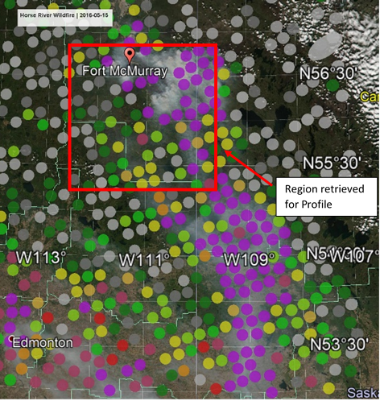
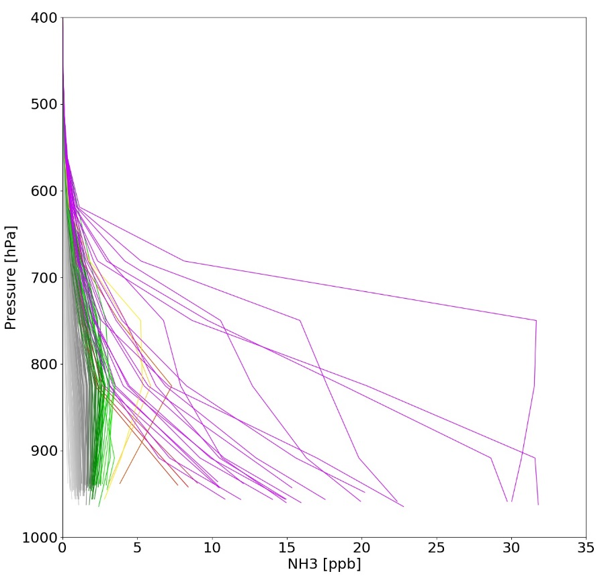
Example of CrIS NH₃ profile retrievals in and around a forest fire plume in Northern Canada
CrIS Surface NH₃ May 15, 2016
CrIS NH₃ Profiles
Profile Plot
Profile coloured to match surface plot
Example of a scene containing low (background), moderate, and elevated (forest fire) NH₃

Slide 4
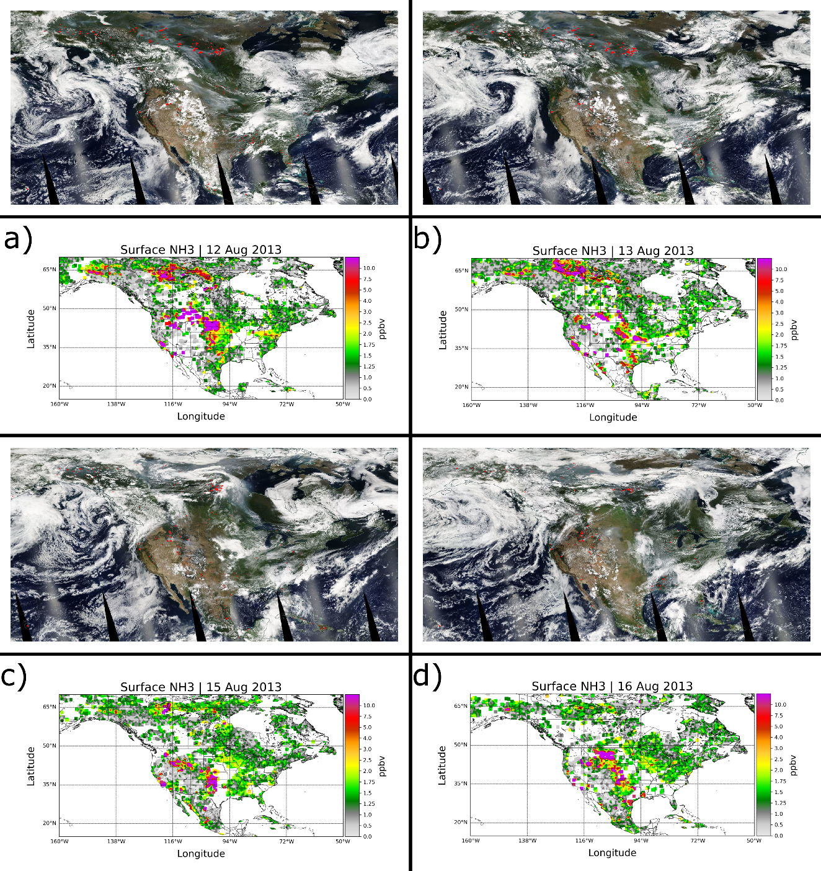
Daily spatiotemporal variability of surface NH₃ over North America in August 2013
True Colour: MODIS
Visible:
  Cloud (White)
  Smoke (blue/gray)
Infrared:
  Fire Detection (red)
CrIS
  Ammonia (NH₃)
  Captures daily spatial distributions of ammonia
      For example: episodic events (e.g. forest fires)
      Impact of the meteorology, cannot “see” through thick clouds
Notes:
MODIS: Moderate Resolution Imaging Spectroradiometer

Slide 5
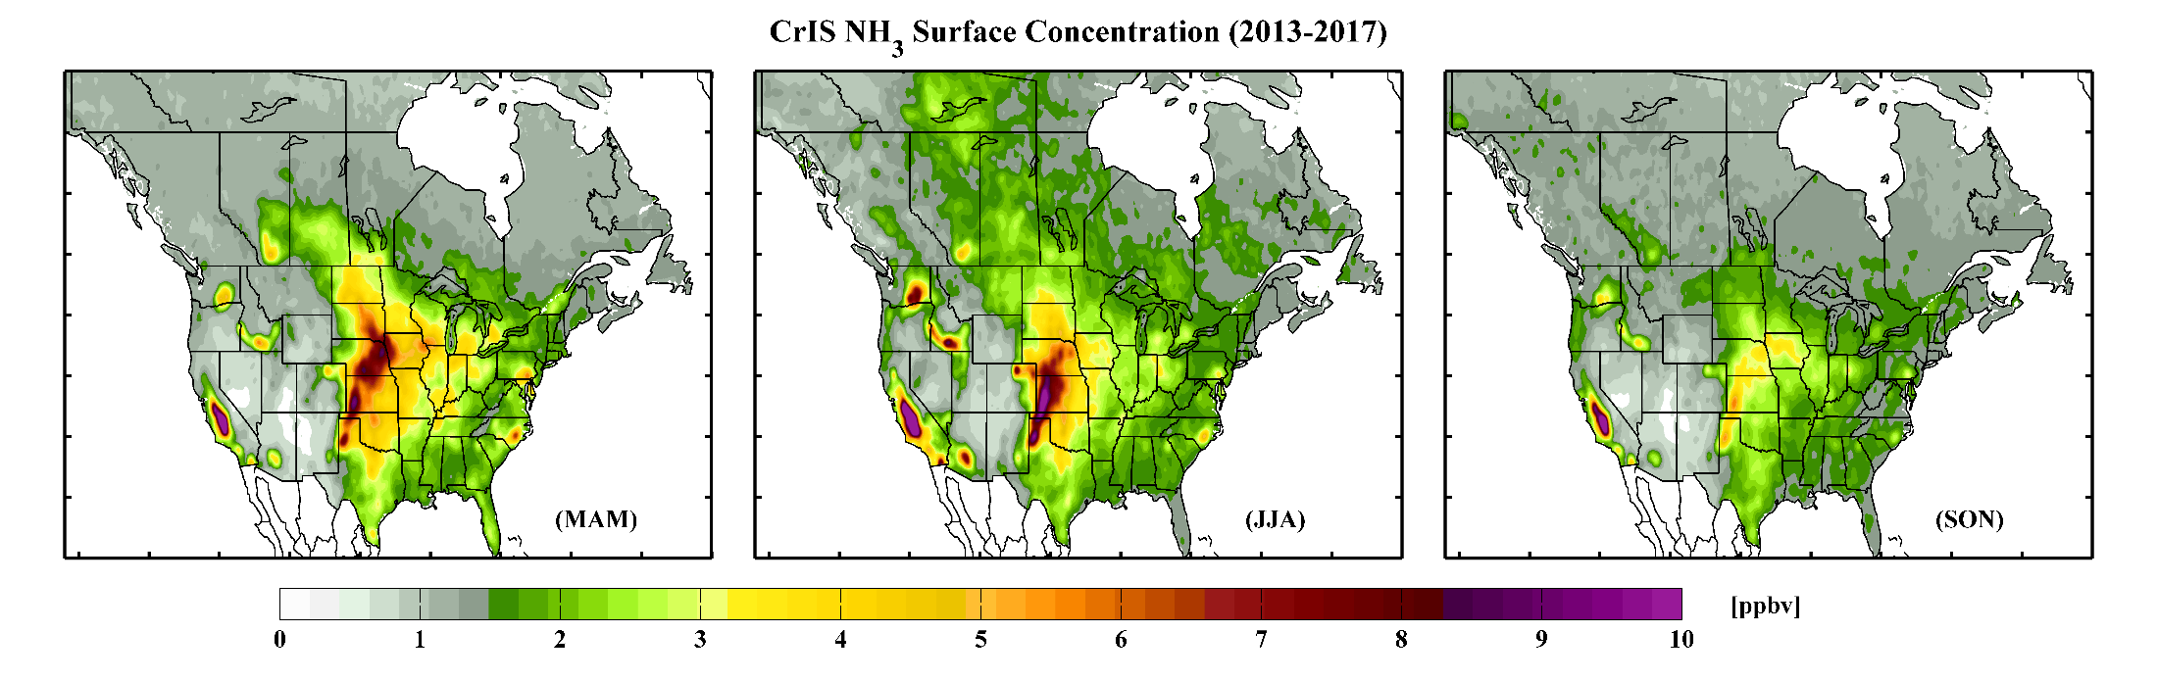
Spatiotemporal variability of surface NH₃ seasonally over North America (2013-2017 average)
Spring
Summer
Large Forest Fires (2014)
Fall
Lethbridge, AB
Wash. St.
Idaho
Central Valley
N. Carolina
US Mid-West
Spring fertilizer applications
Warmer temperatures
  More forest fires
  More volatilization
Reduced concentrations over seasonal crop regions
  Cooler
  Less fertilizer application
  Less forest fires
Spring fertilizer applications
  Captures expected spatiotemporal distributions of ammonia

Slide 6
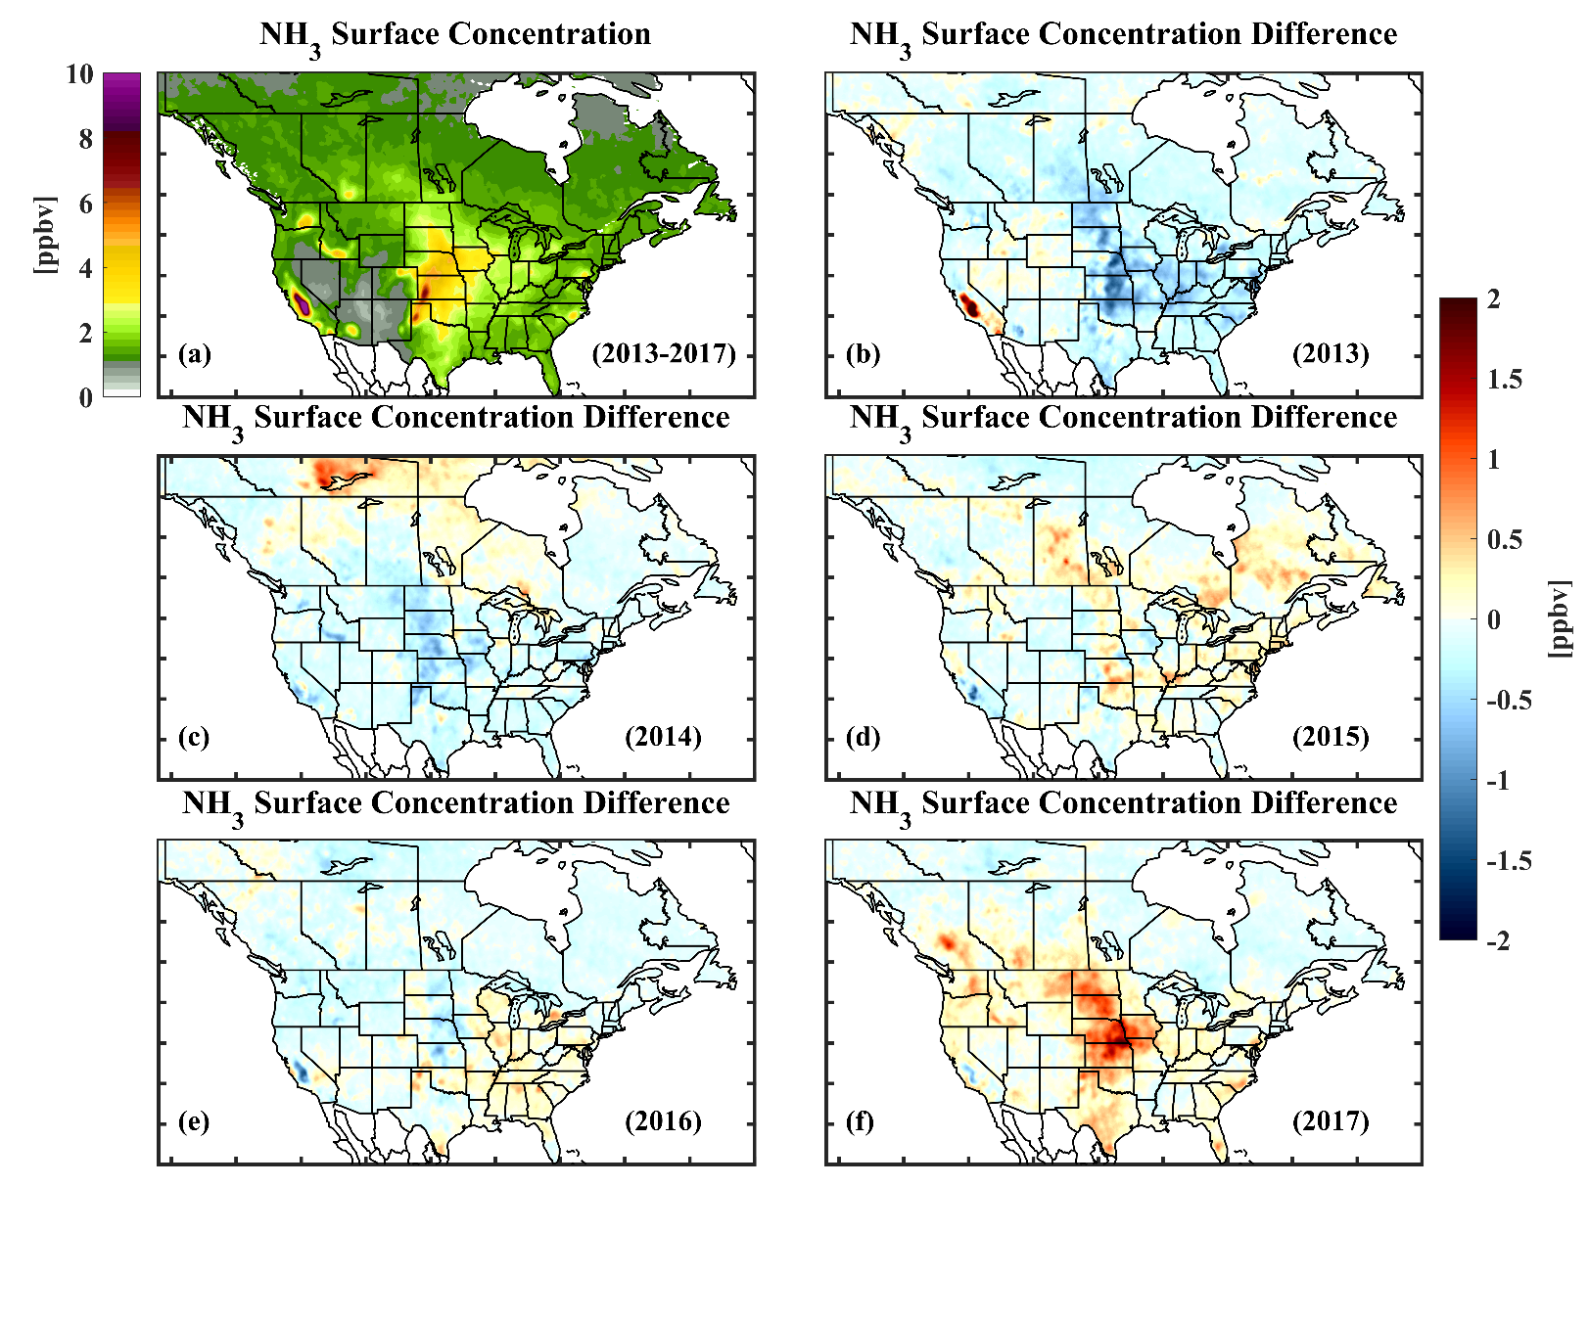
Annual Spatiotemporal Variability of Surface NH₃ over North America (2013-2017)
  Captures spatial distributions of ammonia over expected “hot-spots” :
  Agriculture regions (e.g. Central Valley, US Mid-West, Lethbridge)
  Impact of large forest fires, especially in northern latitudes (e.g. 2014, 2015)

Slide 7
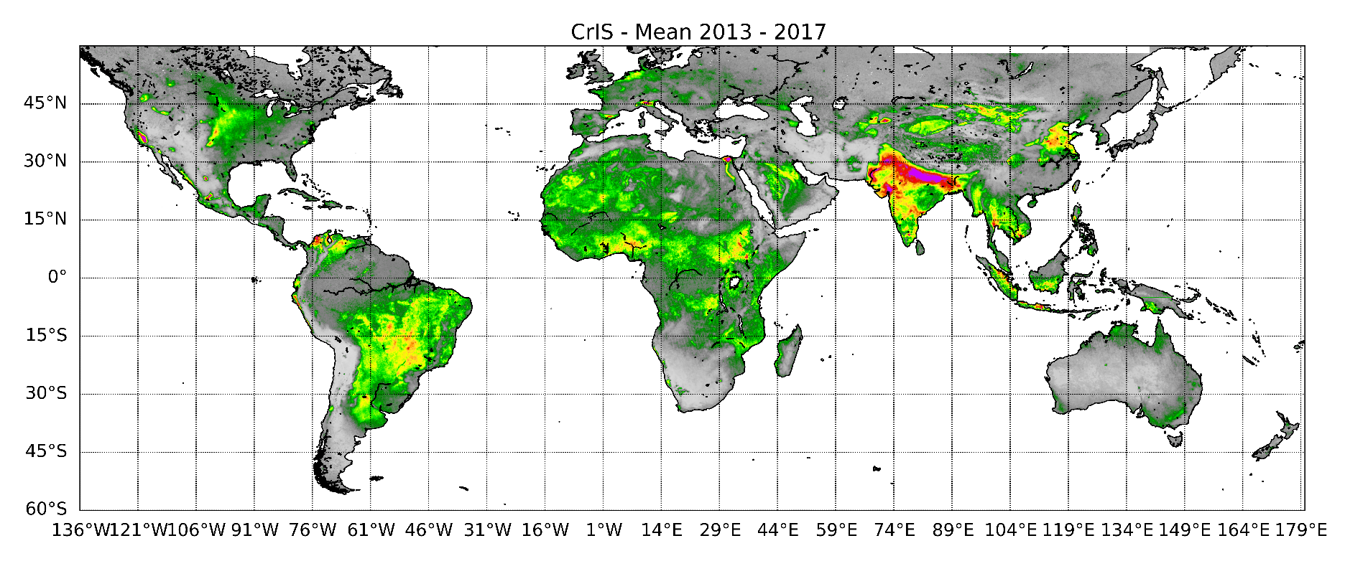
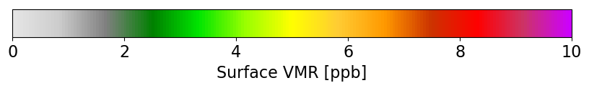
Multi-year CrIS Surface NH₃ Globally (2013-2017)
  Newly generated average global results
  Captures spatial distributions of ammonia over expected “hot-spots”

Slide 8
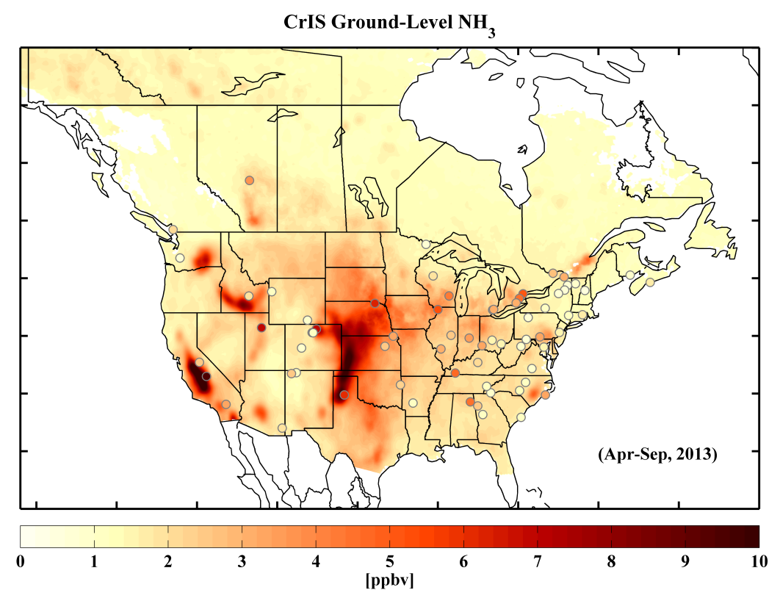
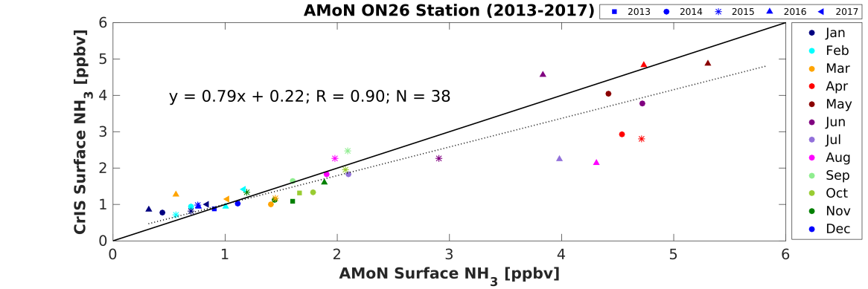
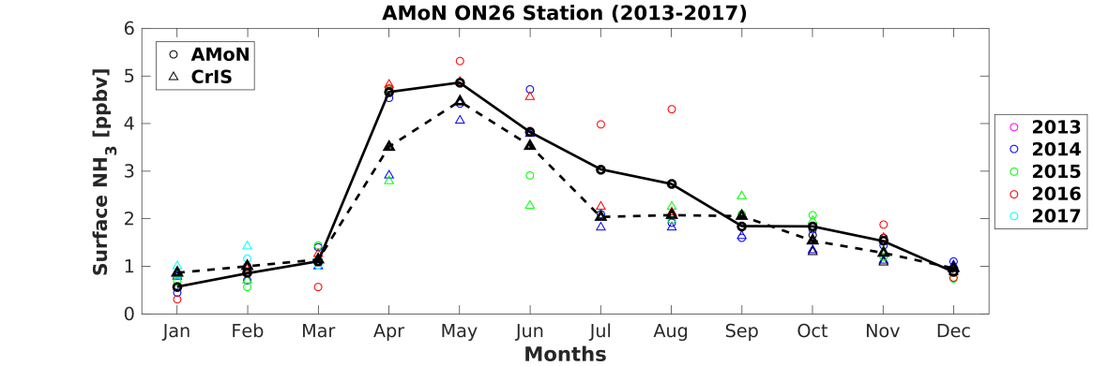
Satellite Ammonia Evaluation
Remotely sensed satellite measurements require validation
Satellite provides global coverage, but at a lower spatial resolution than point source in-situ (e.g. ground- and aircraft-based) observations
  58 Ammonia Monitoring Network (AMoN) sites (USA) : bi-weekly
  10 National Air Pollution Surveillance Program (NAPS) sites (Canada) : 3-day
Longwoods, Southern Ontario, Canada
Surface Site
Ground
Satellite
Preliminary assessment shows that the satellite and surface observations (AMoN) agree well despite sampling differences, especially for more homogenous conditions
Correlation of 0.76; Mean difference of +0.4 ppbv (~+15%)
Notes:
Surface Station Networks:
AMoN: Ammonia Monitoring Network (USA)
NAPS: National Air Pollution Surveillance Program (Canada)

Slide 9
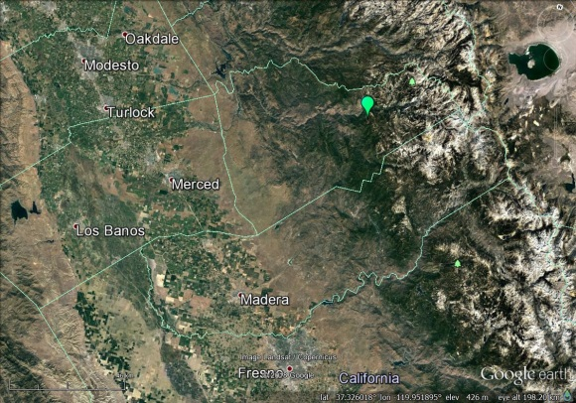
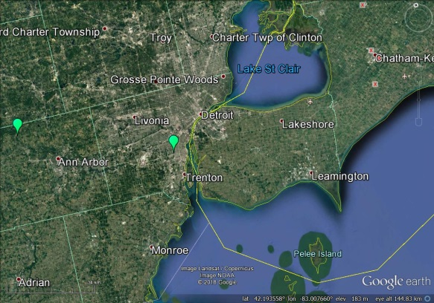
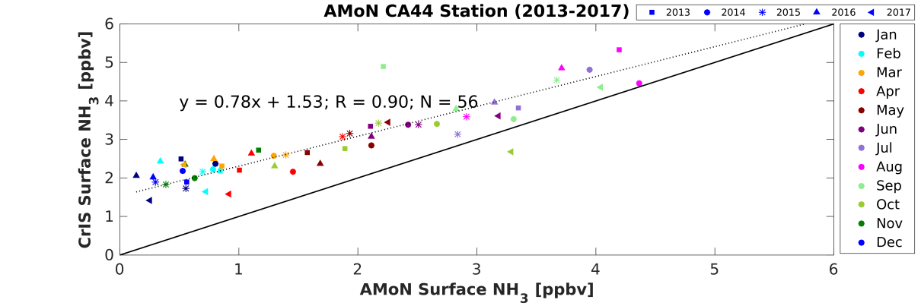
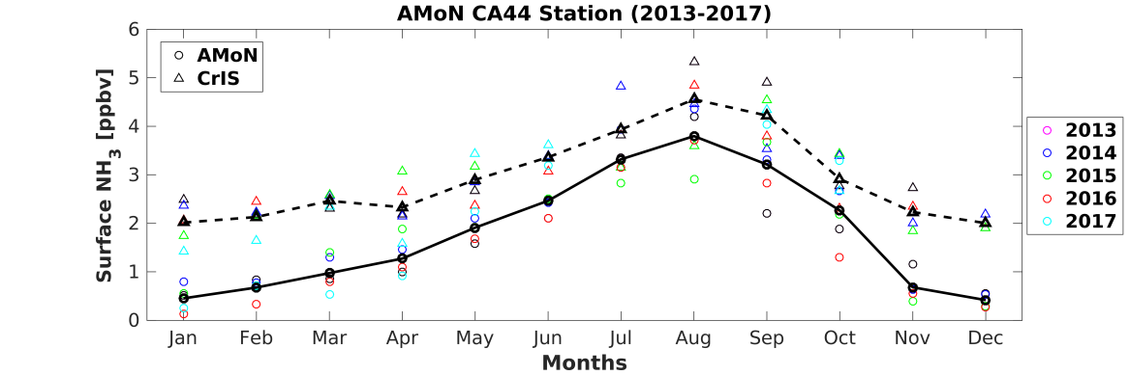
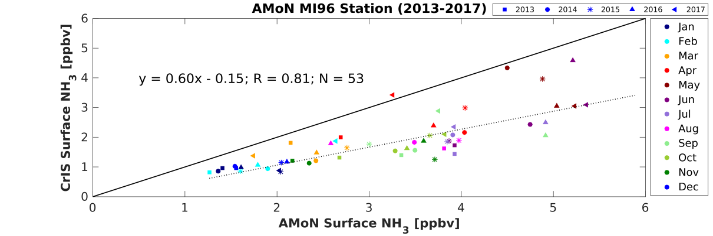
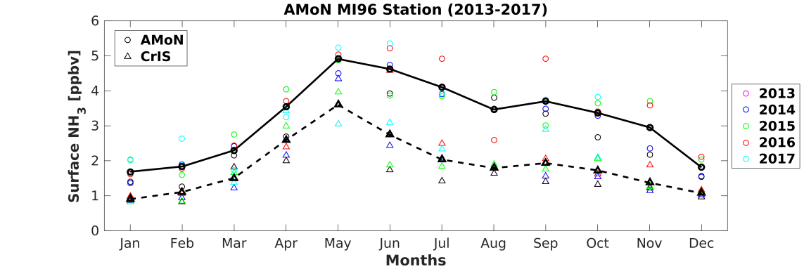
Satellite Ammonia Evaluation
Yosemite NP - Turtleback Dome, California (CA44) (elevation at ~1.5 km)
Detroit (MI96)
Central Valley Agriculture
Sierra Nevada Mountains
Lake Erie
Yosemite NP - Turtleback Dome, California (CA44)
Satellite
Ground
Detroit, Michigan (MI96)
Ground
Satellite
Examples with similar seasonal patterns (correlated), but less agreement in magnitude
  Potential sampling differences in less homogeneous conditions
  Investigating making the satellite and ground-based comparisons more representative
Notes:
Surface Station Networks:
AMoN: Ammonia Monitoring Network (USA)
NAPS: National Air Pollution Surveillance Program (Canada)

Slide 10
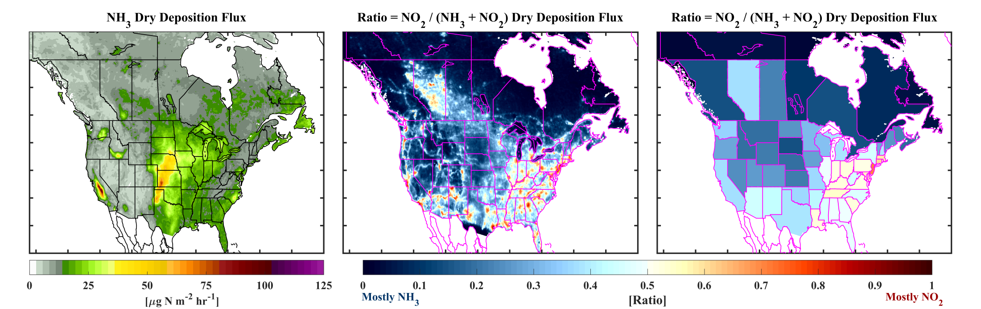
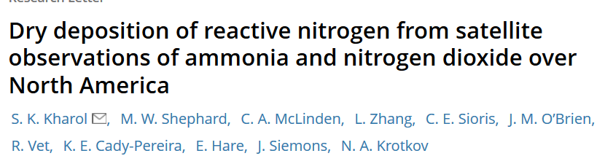
Satellite-derived dry deposition of reactive nitrogen (Nr) from NH₃ and NO₂ over North America
Flux = - Deposition Velocity x Surface Concentration
Modelled
Meteorological Data + Big-Leaf Model (BLM)
(Leiming Zhang et al., 2003 (ACP))
Satellite Observations
CrIS NH₃ & OMI NO₂
2013
NH₃ Dry Deposition Flux
Ratio, NO₂ / (NH₃ + NO₂) Dry Deposition Flux
Mostly NH₃
Mostly NO₂
Dry deposition of NH₃ resembles spatiotemporal patterns of concentrations
NH₃ dry deposition flux peaks in agricultural and remote regions (e.g. Mid-West)
NO₂ dry deposition flux dominates in urban regions (power plants) (e.g. North-East)
Need validation data!
Shailesh Kharol
Notes:
OMI: Ozone Monitoring Instrument (OMI): 2004 until present. Measures NO2 using UV/VIS part of the spectra.

Slide 11
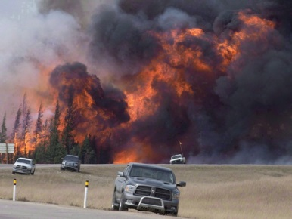
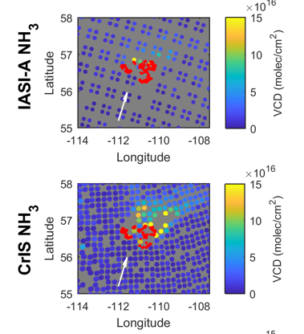
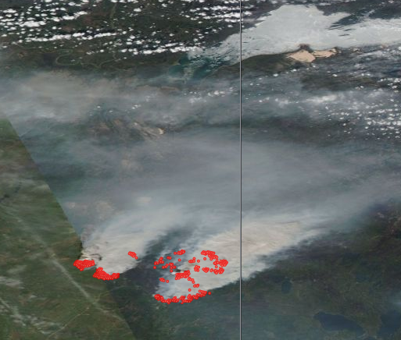
Satellite Derived Emissions: Fire Source
Emissions: mass / time
cbc.ca
Mass in the box
Satellite Column Density x Area x MolecMass
Rate mass leaves box
Winds from Weather Prediction Model
May 16 2016
Satellite (MODIS) image of smoke and hotspots from Canadian Fort McMurray fires
May 16 2016
EOSDIS Worldview
Cristen Adams
Combine satellite observations with model winds to derive fire emissions
Very large signal → single day emission estimates can be derived

Slide 12
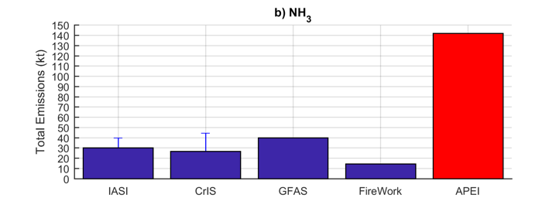

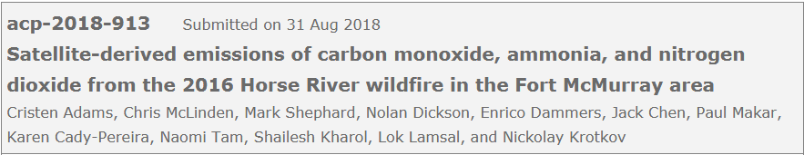
Satellite Derived Emissions: Fire Source
Total Emissions
Fire Emission Models:
ECMWF Global Fire Assimilation System (GFAS)
Fireworks: ECCC Fireworks model
Emission Inventory:
ECCC Air Pollutant Emissions Inventory (APEI)
Satellites
Models
Anthropogenic
Satellite and model emissions agree pretty well for the Fort McMurray fires
Total Fort McMurray fire emissions are significant compared with anthropogenic
  This fire (burning for a month) is equal to ~20% of the annual anthropogenic emissions for the whole province of Alberta, Canada

Slide 13
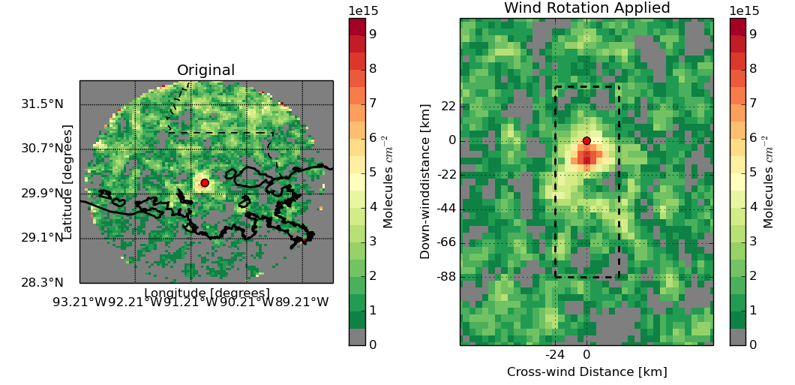
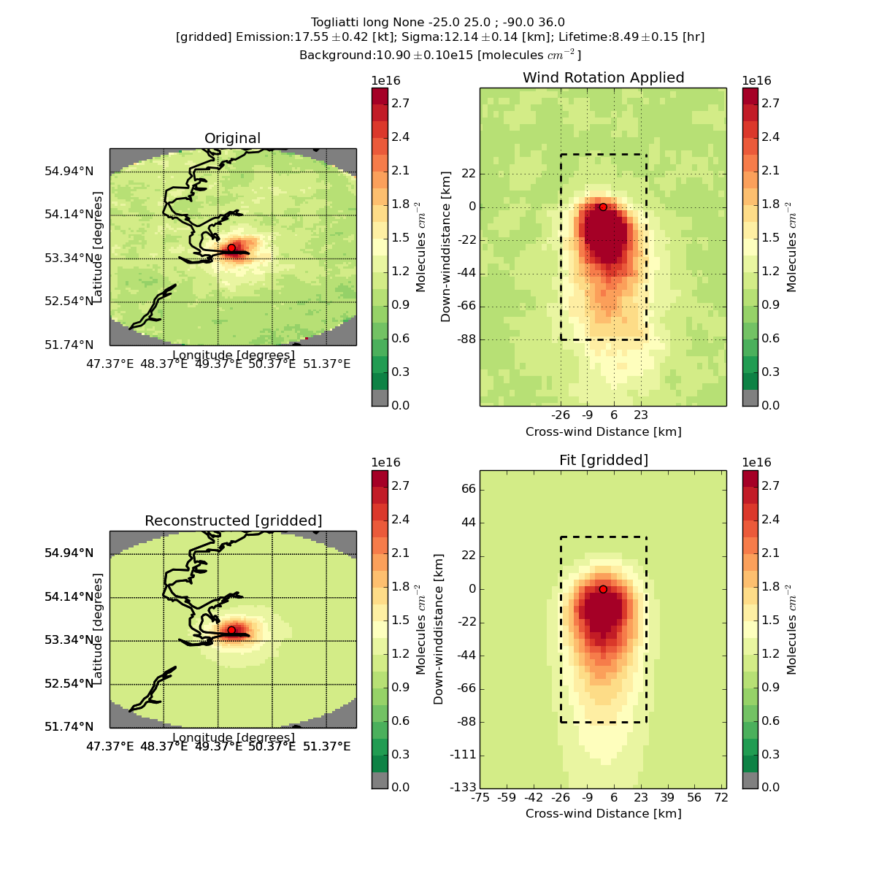
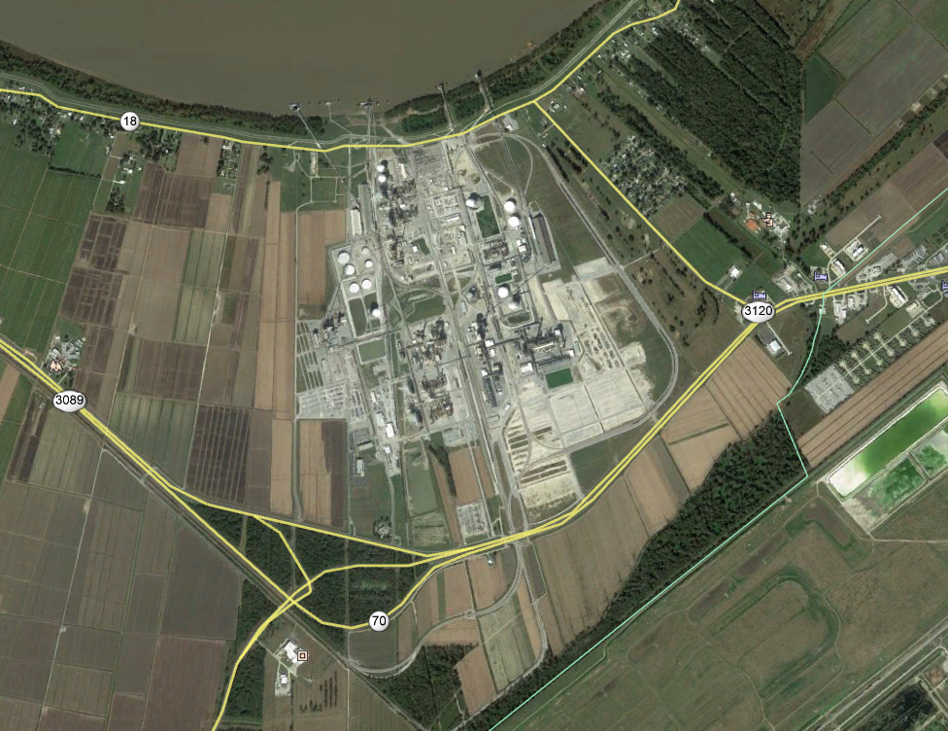
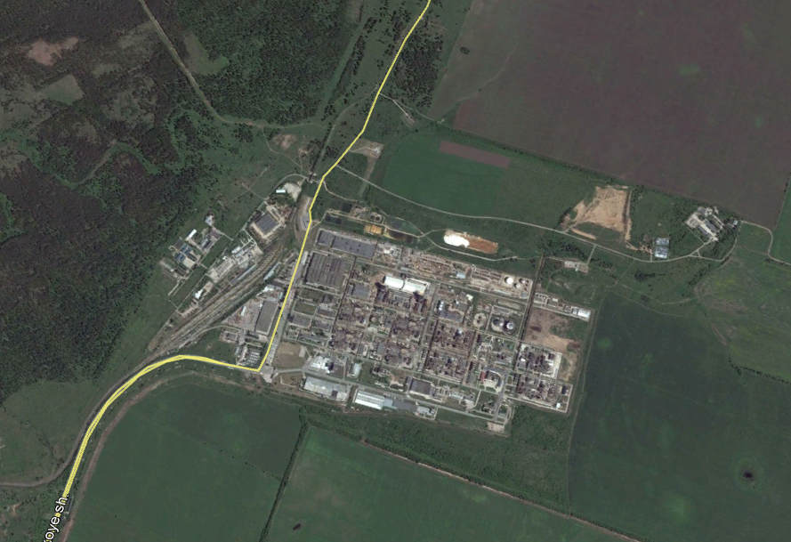
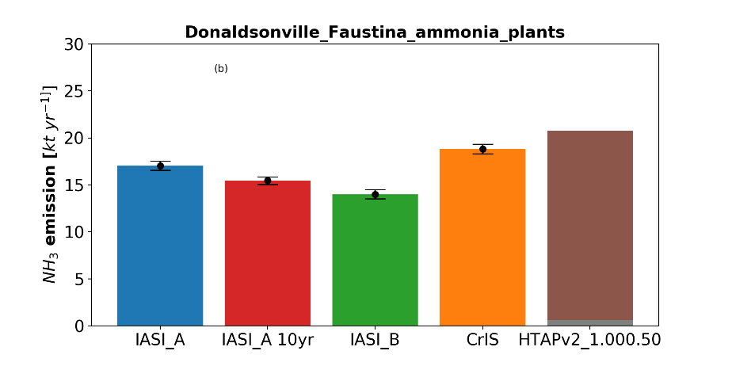
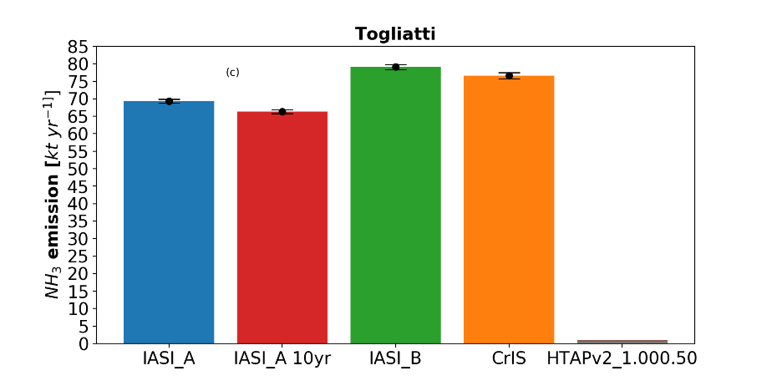
Satellite Derived Emissions: Point Source (Ammonia Factories)
Weaker sources → use average of annual observations
Use wind rotation to orientate observations in upwind and downwind plume
Fit observations with Gaussian plume model to obtain emissions and lifetimes
Donaldsonville ammonia, United States
[IASI-A, 2013-2018]
TogliattiAzot, Russia
[CrIS, 2013-2018]
Satellites
Inventory
Satellites
Inventory
Examples where satellite derived emissions agree well with inventories for some locations, where others are completely missing in the current inventories
Enrico Dammers et al., in preparation
Notes:
HTAPv2: Hemispheric Transport of Air Pollutants
NEI: National Emissions Inventory (US EPA)
E-PRTR: European Pollutant Release and Transfer Register

Slide 14
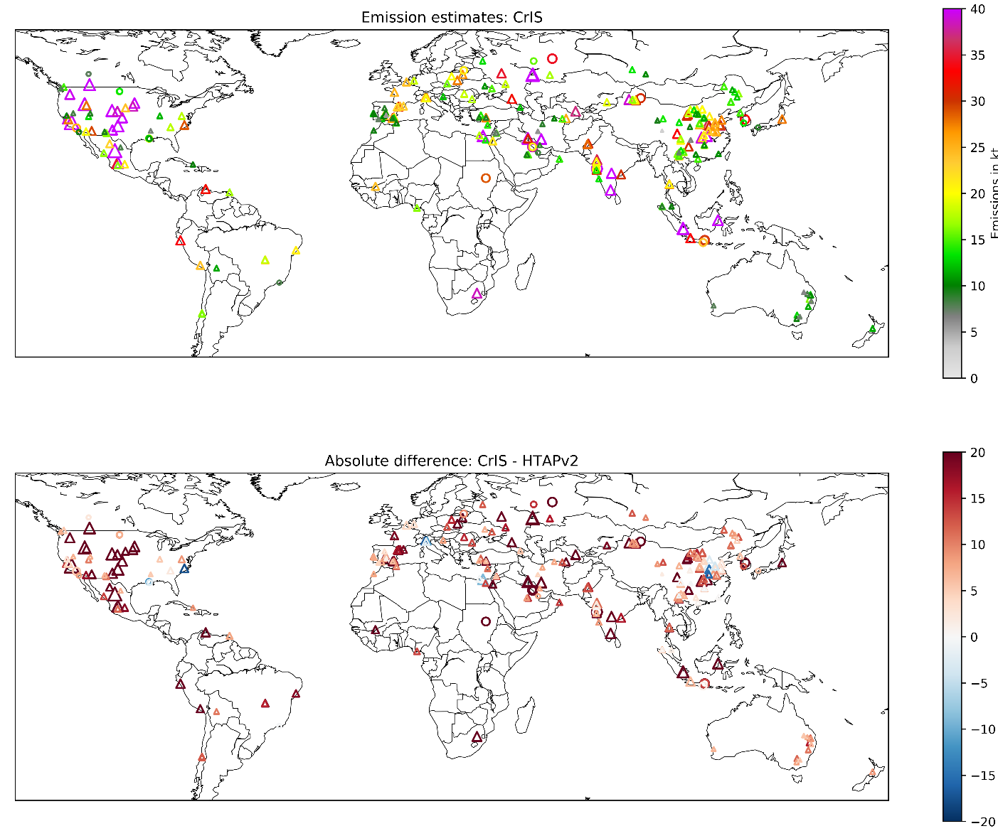
Satellite Derived Emissions from Industry and Agriculture Sources
Agriculture dominated in HTAP
CrIS Emission Estimates
Industry
Emissions [kt/yr]
CrIS – HTAPv2 Emissions
Difference [kt/yr]
Emission estimates globally for larger industrial and agricultural sources (>6 kt/yr)
Generally the HTAPv2 global emissions inventory underestimates by a factor of 2
Average fitted NH₃ lifetime for these sources is 2.5 ± 1 hr
Enrico Dammers et al., in preparation
Notes:
HTAP: Hemispheric Transport of Air Pollutants
EDGAR: Emission Database for Global Atmospheric Research
GEM-MACH: Global Environmental Multi-scale Modelling air quality and Chemistry (GEM-MACH).

Slide 15
Remarks
Provided examples of CrIS NH₃ retrievals and initial applications
    Recently finished the global retrievals from 2013-2017 (v1.5)
      Still making improvements (average products)
      Good initial comparisons of satellite with ground-based observations
      Requires more validation: concentrations and dry deposition
Important applications we did not show here is the use of satellite observations for air quality model evaluation and data assimilation
Satellite remote sensing should be viewed as complimentary to conventional surface and aircraft monitoring
  Has advantages (i.e. fill in gaps in surface networks) and disadvantages (i.e. daily observations at regional scale (~10km))
Lots of progress → but still developing and exploring potential applications

Slide 16
Contributions
Satellite Ammonia | Karen Cady-Pereira (AER), Enrico Dammers (ECCC), Shailesh Kharol (ECCC;UofT), Jesse Thompson (ECCC,UofW), Andrew Kovachik (ECCC) , Yoni Gainariu-Matz (ECCC),Chris McLinden (ECCC), Chris Sioris (ECCC), Debora Griffin (ECCC), Martin Van Damme (ULB), Simon Whitburn (ULB), Lieven Clarisse(ULB) Pierre Coheur (ULB)
Validations | Enrico Dammers (ECCC), Shailesh Kharol (ECCC;UofT) Ed Hare (ECCC), Jason O’Brien (ECCC), Ewa Dabek (ECCC) AMoN and NAPS Data Providers
Model Evaluation | Shabtai Bittman (AAFC), Paul Makar (ECCC), Cynthia Whaley (ECCC), Junhua Zhang (ECCC) Leiming Zhang (ECCC)
Dry Deposition | Shailesh Kharol(ECCC;UofT); Leiming Zhang (ECCC)
Emissions | Enrico Dammers(ECCC), Vitali Fioletov(ECCC), Chris McLinden(ECCC)
+ others
Agriculture and Agri-Food Canada (AAFC), British Columbia, Canada
Atmospheric and Environmental Research (AER), Lexington, MA, USA
Environment and Climate Change Canada (ECCC), Toronto, Ontario, Canada
Environmental Monitoring and Science Division, Government of Alberta, Edmonton, Alberta, Canada (EMSD)
University of Toronto, Toronto, Ontario, Canada(UofT)
University of Waterloo, Waterloo, Ontario, Canada (UofW)
University of Bremen, Bremen, Germany IUP-Bremen
Universite Libre Bruxelles, Brussels, Belgium (ULB)
THANKS!

Slide 17
Background Slides

Slide 18
Application to emissions
Emissions are derived by combining vertically-integrated profiles (columns) with winds from a meteorological reanalysis (here ECMWF)
We consider two approaches:
  Direct : Single overpass for larger sources ➔ wild fires
  (similar to Mebust et al., ACP, 2011)
  Statistical : Multiple overpasses for smaller, more constant sources
  ➔ agricultural sources (Fioletov et al., GRL, 2015)
    requires the use of a rotation scheme in order to align the wind direction of all observations (Pommier et al., GRL, 2012; McLinden et al., Nature, 2016)

Slide 19

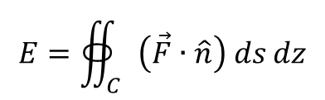

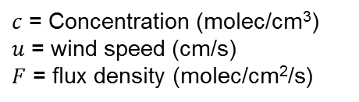
Direct method for satellite emissions
1) Direct Method (simple)
  Applicable for larger sources where SNR is high and plumes can be resolved with a single overpass
  Satellite concentrations are directly combine with wind information to compute the flux density for a box around the emission source aligned with the wind, which is then integrated to get fire emission estimates
  Few sources meet this criteria
    e.g. Forest fires
$$\overset{⃑}{F}=c\left(s,z\right)\overset{⃑}{u}(s,z)$$
$c$ = Concentration (molec/cm³)
$u$ = wind speed (cm/s)
$F$ = flux density (molec/cm²/s)
Wind
$$E=∯_{C}{\left(\vec{F}∙\hat{n}\right) ds dz}$$
$$C$$
Estimated effective lifetimes are used to account for in-box loss

Slide 20
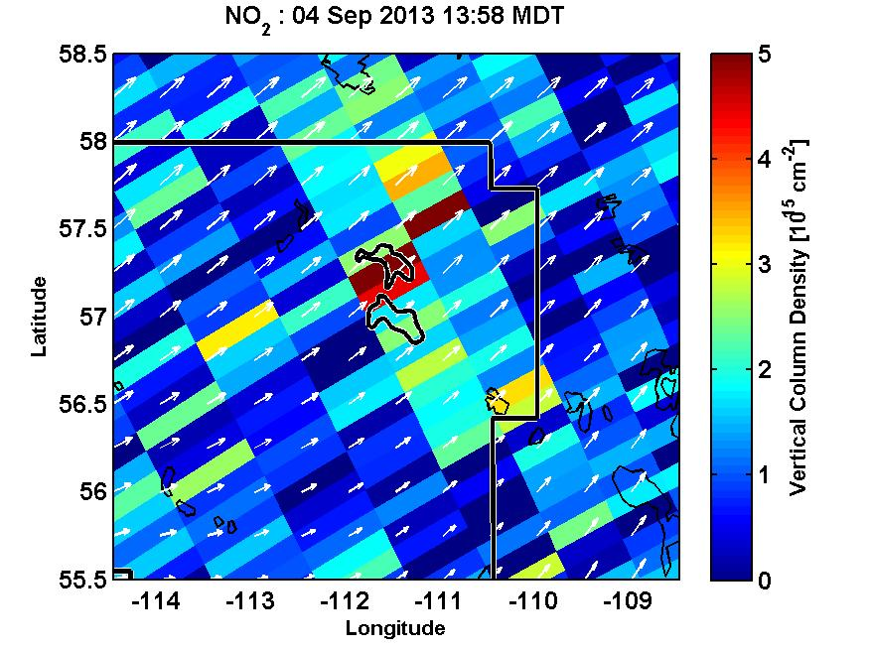
Statistical Approach
NO₂ over the oil sands from a single overpass of the Ozone Monitoring Instrument
2) Statistical method
  Resolution of satellite observations are large compare to the emissions
  Single-measurement has a lower SNR
To overcome these challenges we combine observations from many overpasses (weeks/months/year or more)
  This averaging leads to improved precision and effective spatial resolution
We use a rotation procedure which allows to combine observations from arbitrary wind direction
  Based on wind direction, individual satellite observations are reposition about a source such that all now share a common wind direction
Fit a plume model to the merged satellite + wind information to analyzed the downwind decay
  Providing estimates of emission rate (E) near the source and its average lifetime (τ).
  E = mass / τ (steady-state assumption)

Slide 21
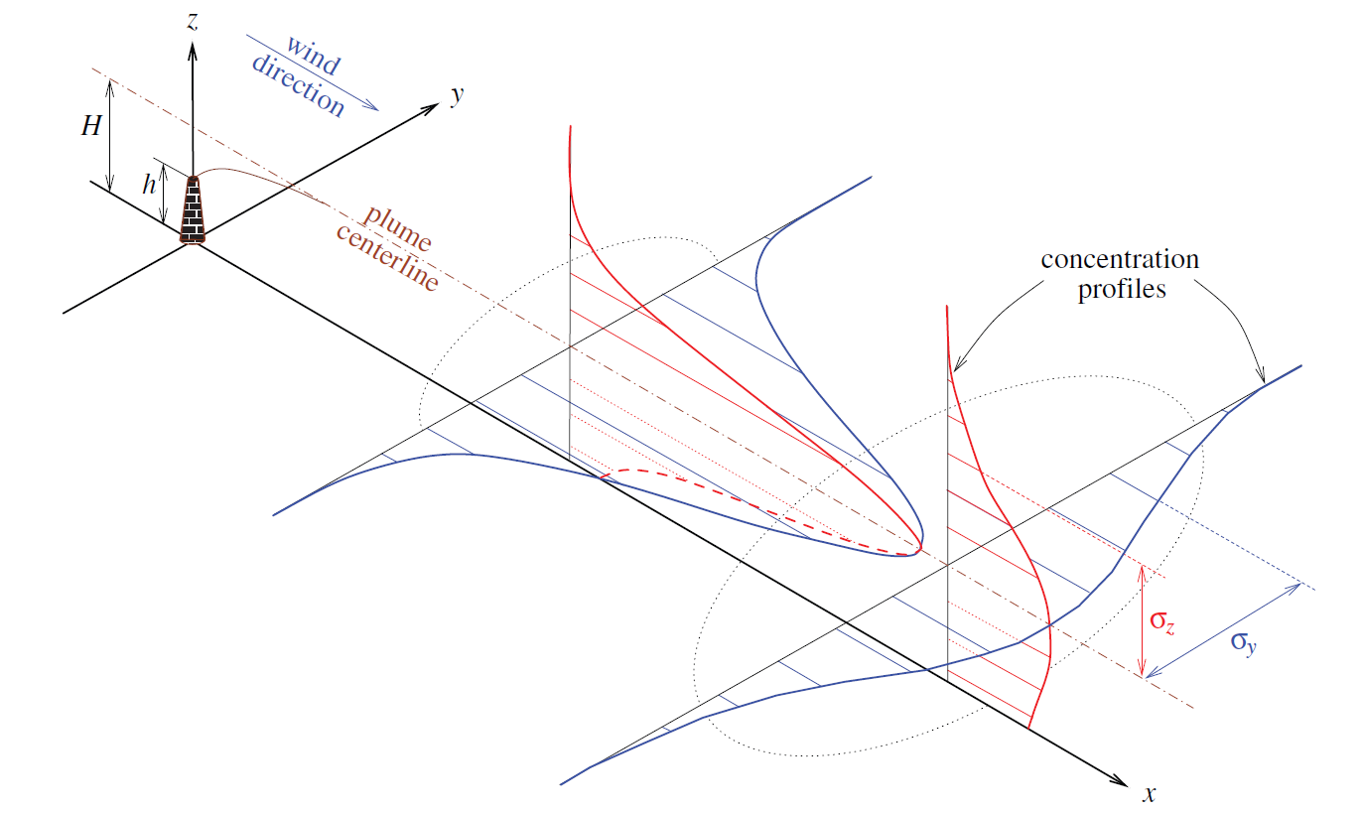
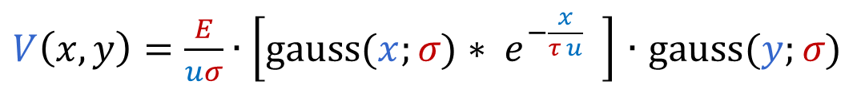
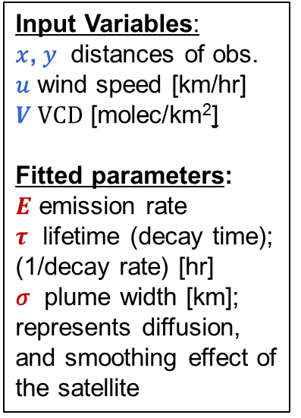
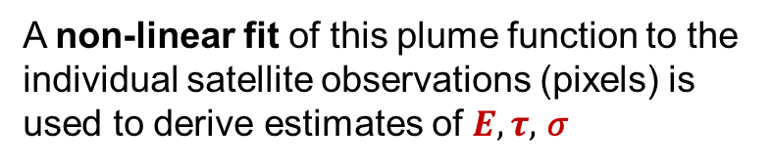
Plume model and fitting (inversion)
Plume model assumes concentrations emitted from a point source decline exponentially in time and affected by turbulent diffusion that can be described by a 2D Gaussian function allowing for:
  1. Simple first-order loss (chemical transformations and deposition)
  2. Coarse spatial resolution (a smeared view by the satellite)
Input Variables:
𝑥, 𝑦 distances of obs.
𝑢 wind speed [km/hr]
$V VCD$ [molec/km²]
Fitted parameters:
$E$ emission rate
$τ$ lifetime (decay time); (1/decay rate) [hr]
𝜎 plume width [km]; represents diffusion, and smoothing effect of the satellite
Downwind distribution
Cross-wind
distribution
$V\left(x,y\right)=\frac{E}{uσ}∙\left[\text{gauss}\text{(}x;σ\text{)}∗{ e}^{−\frac{x}{τ u}} \right]$ $∙$ $\text{gauss}\text{(}y;σ\text{)}$
convolution
exponential decay
Standard Gaussian Plume
A non-linear fit of this plume function to the individual satellite observations (pixels) is used to derive estimates of $E,τ,$ 𝜎
Stockie, SIAM Review, 2011

Slide 22
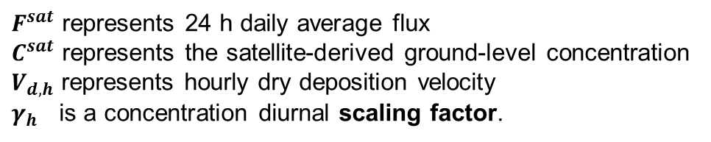
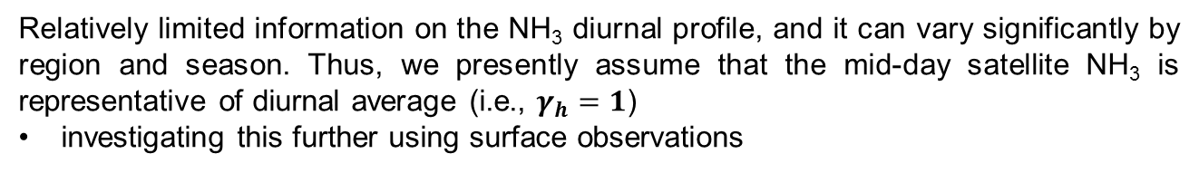
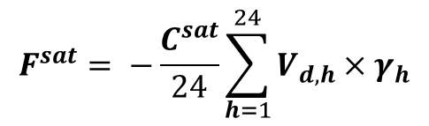


Satellite derived Dry Deposition Flux of NH₃ & NO₂
We use the model diurnal profile to calculated the 24 hr daily average flux as follows:
$$F^{sat}= −\frac{C^{sat}}{24}\sum_{h=1}^{24}{V_{d,h}×γ_{h}}$$
$F^{sat}$ represents 24 h daily average flux
$C^{sat}$ represents the satellite-derived ground-level concentration
$V_{d,h}$ represents hourly dry deposition velocity
$γ_{h}$ is a concentration diurnal scaling factor.
For NO₂:
$$γ_{h}=C_{h}^{GM}/C_{sat overpass}^{GM}$$
$C_{h}^{GM}and C_{sat overpass}^{GM}$ represent hourly and satellite overpass time mean ground-level concentration from the GEM-MACH air quality model
For NH₃:
$$γ_{h}=1$$
Relatively limited information on the NH₃ diurnal profile, and it can vary significantly by region and season. Thus, we presently assume that the mid-day satellite NH₃ is representative of diurnal average (i.e., $γ_{h}=1$)
investigating this further using surface observations
Shailesh Kharol

Slide 23
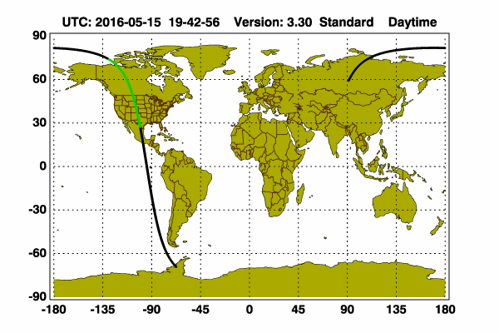
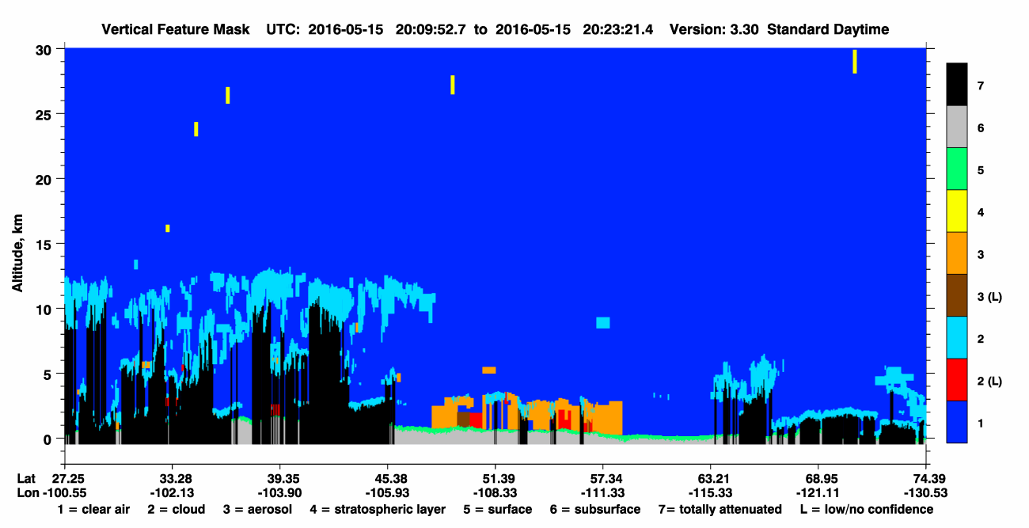
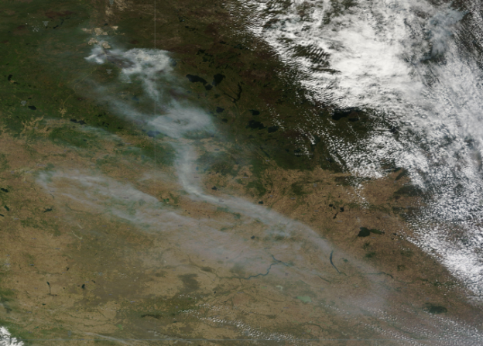
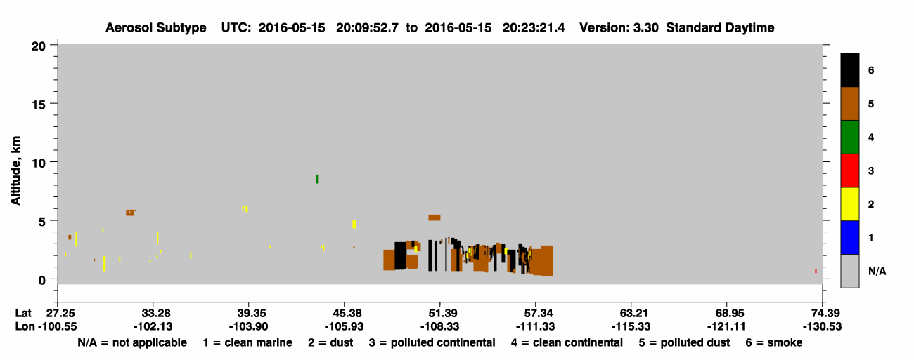
Any Fire Plume Heights Information?
CALIPSO (70m) : LIDAR “pencil beam”
- High vertical resolution, but sparse coverage
Smoke Plume Heights of ~3km
Fort McMurray _{x}
Terra MODIS
True Color Composite 15th May 2016

Slide 24
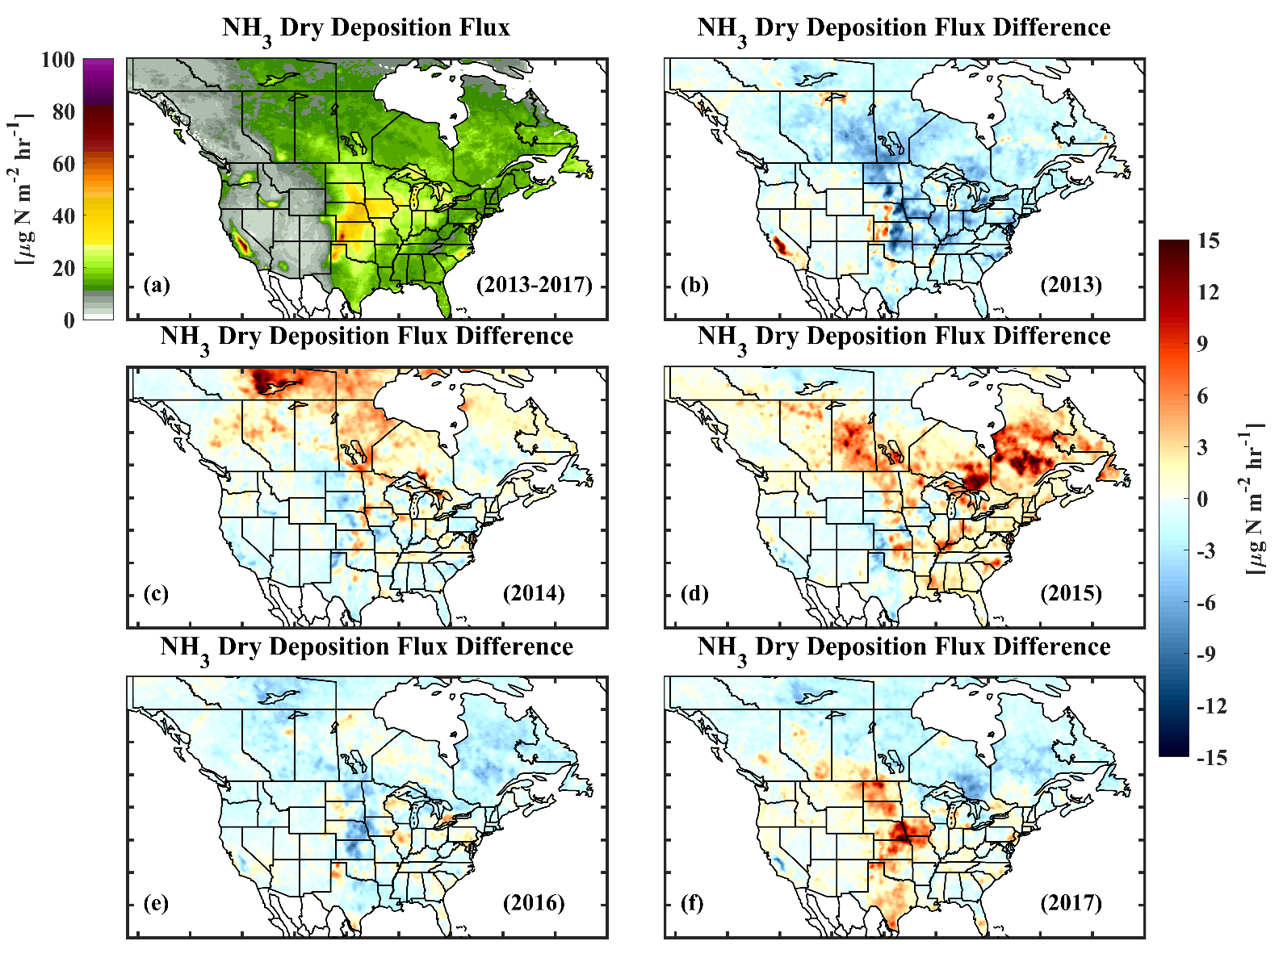
Satellite-derived reactive nitrogen (Nr) dry deposition from NH₃ over North America (2013-2017)
Variability from year-to-year resembling the concentrations maps
Large forest fires impact on northern latitudes in some years (e.g. 2014)
Need more ground-based dry deposition measurements for validation!

Slide 25

CrIS noise comparison with IASI and AIRS
IASI ~0.20 K
AIRS ~0.15 K
CrIS ~0.05 K
NH₃ 967 cm⁻¹
Reference: Zavyalov, V., et al. (2013), Noise performance of the CrIS instrument, J. Geophys. Res. Atmos., 118,13,108–13,120, doi:10.1002/2013JD020457.

